Slide 1

Transformers and Large Language Models
Dr S.Natarajan
Professor and Key Resource Person
Department of Computer Science and Engineering
PES University
Bengaluru, India
+919945280225
Lecture delivered on April 20th , 2024 Forenoon Session to the CSE students of PES University

Slide 2

Foundation Models –their origin
Take knowledge from one task (e.g. object recognition in images) apply
it to another task (e.g. activity recognition in videos)
In deep learning, the dominant paradigm is pretraining:
train a model on a surrogate (background) task
• adapt by fine-tuning on the task of interest
Foundation models are powerful transfer learners due to their scale
Ingredients of scaling:
computer hardware improvements (e.g. GPUs and memory)
•Transformer architectures (leverage parallelism, expressivity)
•Availability of training data

Slide 3
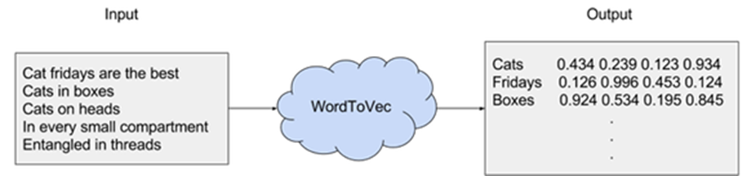
Self Supervision, Auto Regression and Transformers
Self-supervised learning is a technique used to train models in which the output labels are a part of the input data Thus no separate output labels are required
It is also known as predictive learning or pretext learning
In this method, the unsupervised problem is changed into a supervised one using auto-generation of labels
Self-supervision has been particularly productive in NLP
Word Embeddings are numeric representations of words in a lower-dimensional space, capturing semantic and syntactic information.
Word embeddings associate words with context-independent vectors:
•Word representations (Turian et al., 2010)
•word2vec (Mikolov et al., 2013)
•GloVe (Pennington et al., 2014)
Autoregressive language modelling (contextual representations):
•seq2seq pre-training with a language model (Dai et al., 2015)
•GPT (Radford et al., 2018)
•ELMo (Peters et al., 2018)
•ULMFit (Howard et al., 2018)
Transformers: BERT, GPT-2, RoBERTa, T5, BART

Slide 4
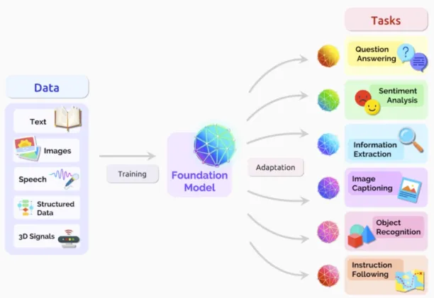
Foundation Model

Slide 5

The naming of Foundation Models
Bommasani et al. introduce the name "foundation models" to describe the recent paradigm shift
Rationale: describe technical attributes of these models
However, these names do not capture the paradigm shift
is too narrow: foundation models go beyond language
and capture their flexibility but do not capture their unfinished character and need for adaptation
captures the manner of training, but not the implications for downstream tasks
is chosen to describe the emerging paradigm
"Foundation" describes the role these models play: a foundation model is incomplete but serves as a
common building block for task-specific models constructed through adaptation
"Foundation" also implies the significance of architectural stability, safety and security:
well-constructed foundations are a solid bedrock for future applications
• Poorly-constructed foundations are a recipe for disaster!
At present, little is known about the nature/quality of the foundation that foundation models provide
Critical problem for researchers, foundation model providers, application developers (who build
atop foundation models), policymakers and society at large to address
pretrained model
self supervised model
Language Model
general purpose
multi purpose
task agnostic model
Foundation model

Slide 6
Homogenization across research communities
Beyond NLP, increasing homogenisation across communities
Transformer-based sequence models are applied to:
•text (BERT)
•images (ViT)
•speech (Mockingjay)
•tabular data (TaBERT)
•protein sequences (ESM-1b)
•organic molecules (C5T5)
•reinforcement learning (Decision Transformer)
A future of unified tools across modalities

Slide 7

Target tasks and datasets
Target tasks are typically supervised and span a range of common NLP tasks:
❏Sentence or document classiﬁcation (e.g. sentiment)
❏ Sentence pair classiﬁcation (e.g. NLI, paraphrase)
❏ Word level (e.g. sequence labeling, extractive Q&A)
❏ Structured prediction (e.g. parsing)
❏ Generation (e.g. dialogue, summarization)

Slide 8
Attention Timeline
1990s
Prehistoric Era
Rule-based methods, parsing, RNNs, LSTMs
2014
Simple attention mechanisms
2017
Beginning of transformers
Attention is all you need
2018
Explosion of transformers in NLP
BERT, GPT-3
2018-2020
Explosion into other fields
Explosion into other fields: ViTs, Alphafold-2.
2021-2022
Start of Generative Era
Codex, Decision Transformers, GPT-X, DALL·E
2024
Present Day
Huge models, more applications: Chat-GPT, GPT-4, Gemini, Llama and open-source LLMs, Whisper, Robotics Transformer, Stable Diffusion, Sora, and so much more…!
Future (?!)

Slide 9

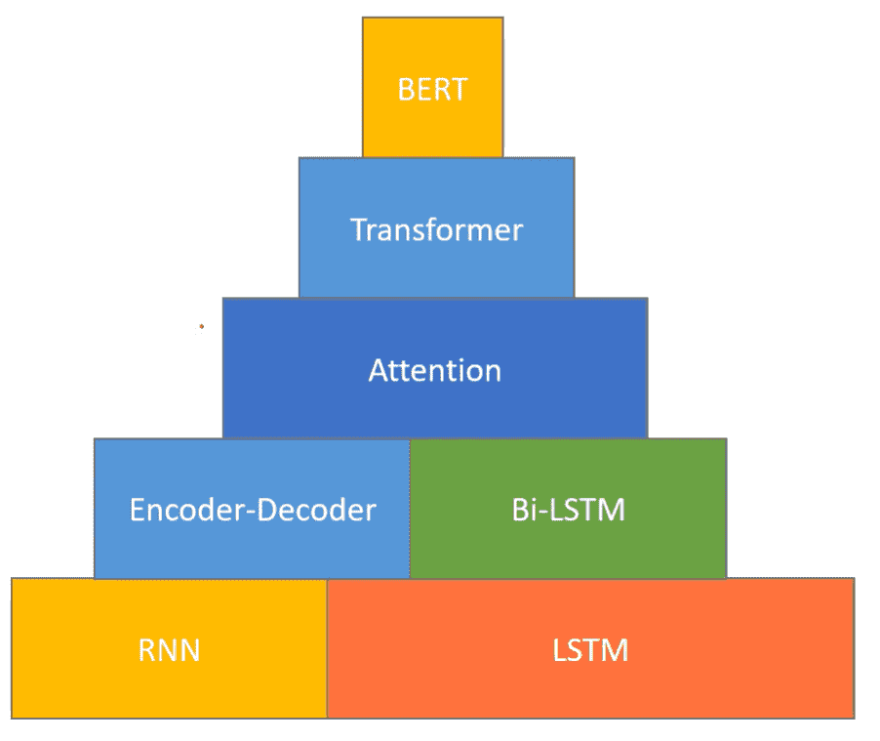
Stages in Language Representation

Slide 10
Pre-training general Language Representations
• Feature based approaches
• Non neural word representations
• Neural embedding
• Word embedding: Word2Vec, Glove, …
• Sentence embedding, paragraph embedding, …
• Deep contextualised word representation ( ELMo , Embeddings from Language
Models) (Peters et al. 2018)
• Fine tuning approaches
• OpenAI GPT (Generative Pre trained Transformer) (Radford et al. al., 2018a)
• BERT (Bi directional Encoder Representations from Transformers) (Devlin et al. al.,
2018) - year of break through in Deep Learning Language Representations

Slide 11

Basic Concepts
SoftMax – Softmax Activation Function is a popular name in Deep Learning
Usually placed as the last layer in the deep learning model
It normalizes the output of a network to a probability distribution over predicted output classes
The softmax function takes as input a vector z of K real numbers
Normalizes it into a probability distribution consisting of K probabilities proportional t
to the exponentials of the input numbers
Formally, the standard (unit) softmax function σ :R^{K} -> (0,1)^{K} where K >= 1
K
(z)_{i} = e^{zi} / Σ e^{zj} for i=1,2,…K and z= (z_{1,} z₂ ,….z_{k}) ε R^{k}
j=1
Word Embedding is an approach for representing words and documents
Word Embedding or Word Vector is a numeric vector input that represents a word in a lower-
dimensional space
It allows words with similar meanings to have a similar representation
Need for Word Embedding?
To reduce dimensionality
To use a word to predict the words around it
Inter-word semantics must be captured

Slide 12
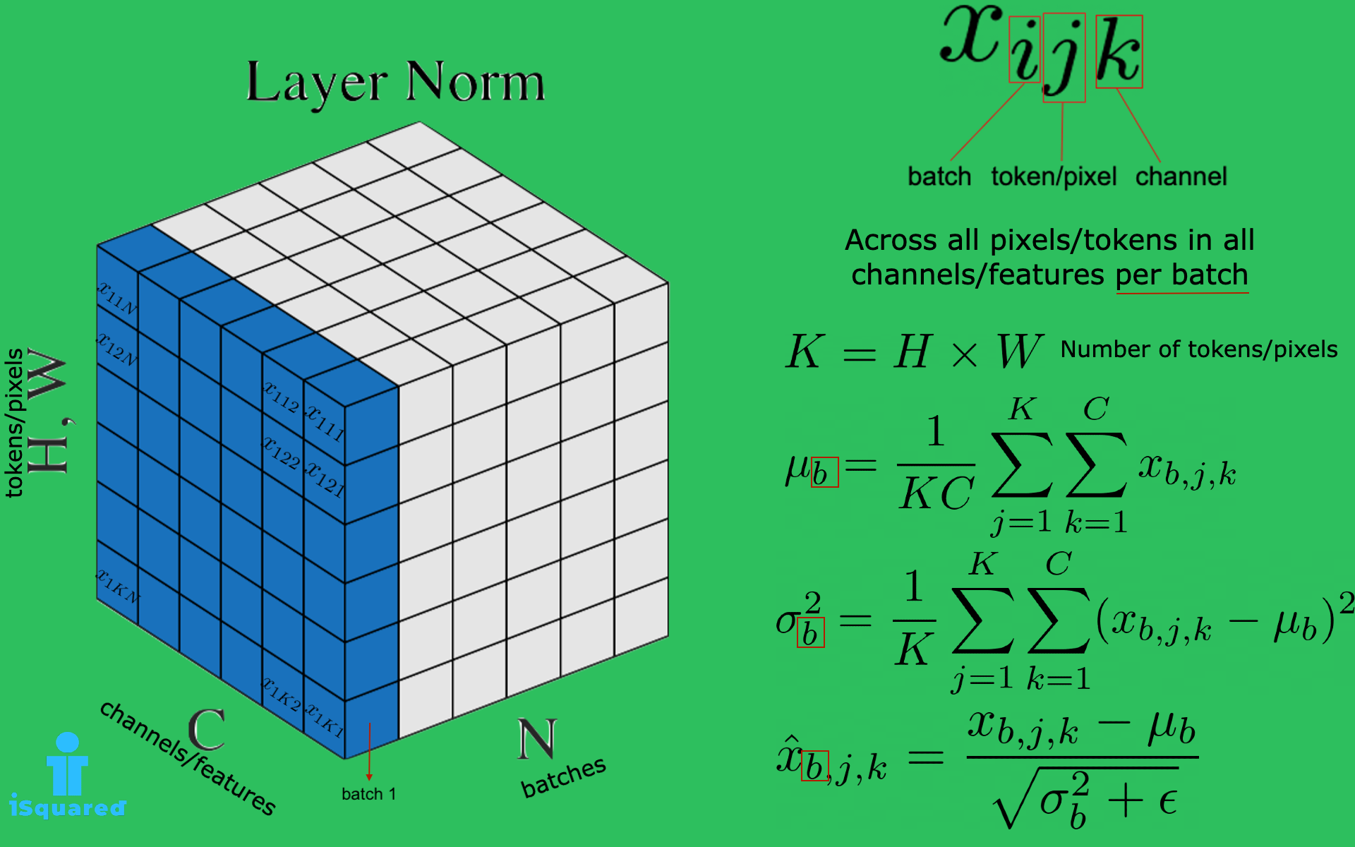
Basic Concepts
Layer Normalization directly estimates the normalization statistics from the summed inputs to the neurons
within a hidden layer so the normalization does not introduce any new dependencies between training cases
Add& Norm -This adds the residual connection for each neural network layer and applies layer normalization
The Transformer model utilizes " Add & Norm " blocks to facilitate efficient training

Slide 13
What is Attention and Self Attention?
Attention
In psychology, attention is the cognitive process of selectively concentrating on one or a few things while ignoring others
A neural network is considered to be an effort to mimic human brain actions in a simplified manner
Attention Mechanism is also an attempt to implement the same action of selectively concentrating on a few relevant things, while ignoring others in deep neural networks
. The main idea behind attention technique is that it allows the decoder to "look back” at the complete input and extracts significant information that is useful in decoding
Self Attention
Let us take the example of a sentence as stated below
Pandava brothers and Kunthi went to the forest , and they stayed there for nearly 14 years
As a human being we can infer Pandava brothers and Kunthi as they and there as forest but the computing systems cannot do
In 2017, the paper entitled “ Attention is all that matters” by Vaswani et al., brought the concept of
Self Attention to address this issue

Slide 14

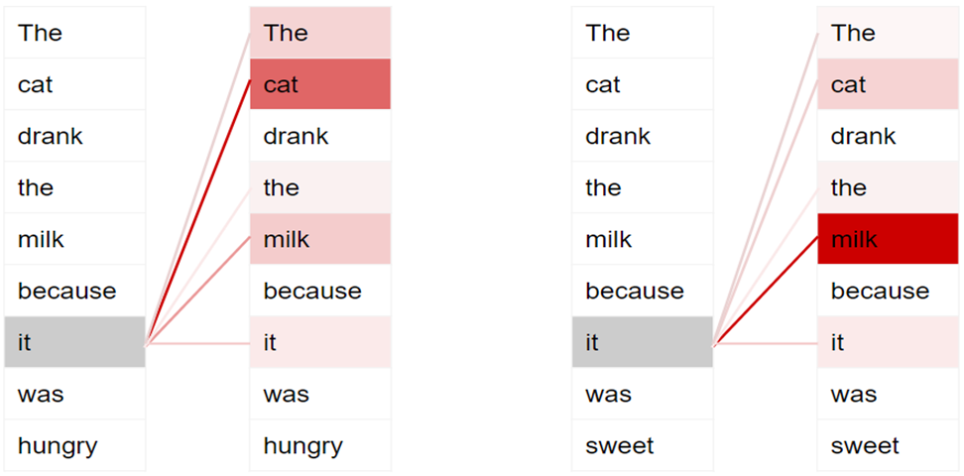
Example of Attention
Dark colors represent higher attention
To enable it to handle more nuances about the intent and semantics of the sentence, Transformers include multiple attention scores for each word

Slide 15

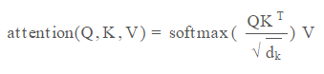
Attention
Allows to “focus attention” on particular aspects of the input text
Done by using a set of parameters, called "weights," that determine how much attention should be paid to each input at each time step
These weights are computed using a combination of the input and the current hidden state of the model
Attention weights are computed (dot product of the query, key and value matrix), then a softmax function is applied to the dot product
https://arxiv.org/abs/1706.03762
https://jalammar.github.io/illustrated-transformer/
d_{k} is the dimension of Key Value

Slide 16
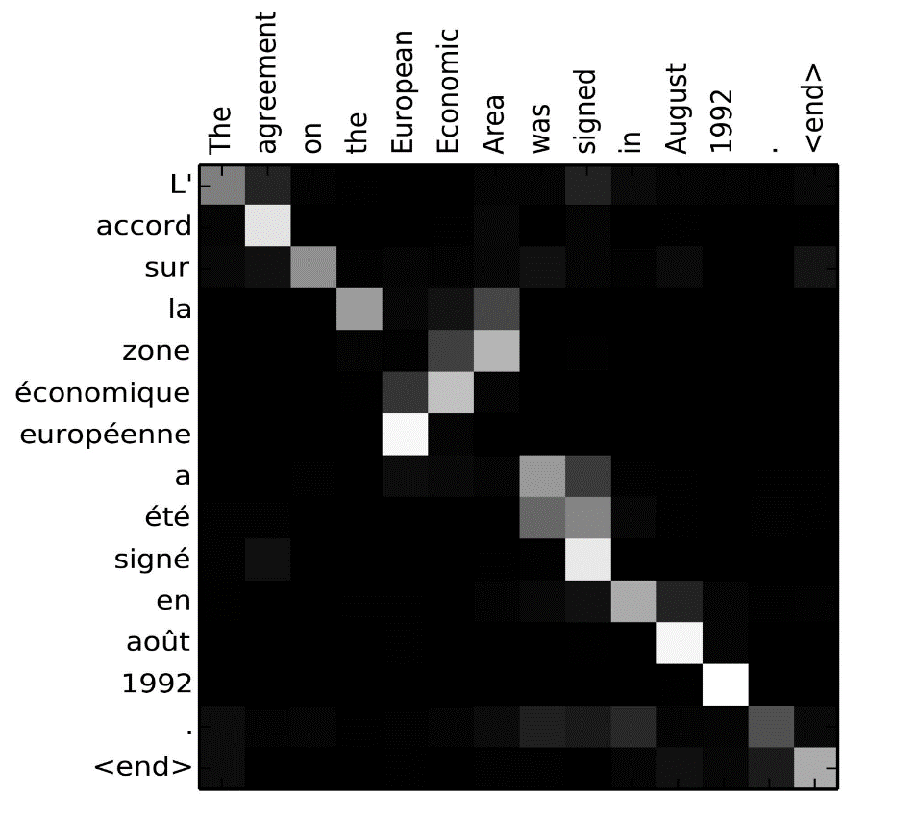
Soft attention
Use a probability distribution over all inputs
Classification assigned probability to all possible outputs
Attention uses probability to weight all possible inputs – learn to weight more relevant parts more heavily.
Content-based attention
Each position has a vector encoding content there
Dot product each with a query vector, then
softmax
The attention mechanism scores each word in the input (via dot product with attention weights), then passes these scores through the softmax function to create a distribution
https://distill.pub/2016/augmented-rnns/

Slide 17
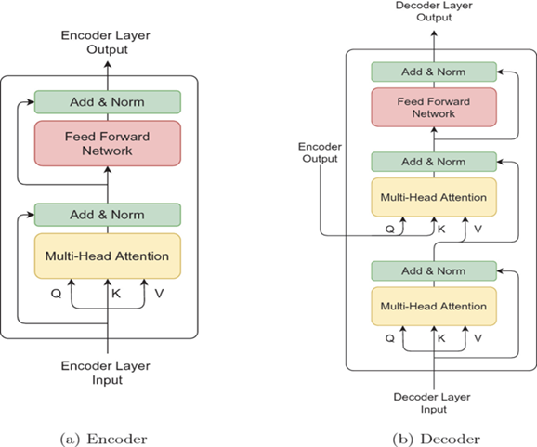
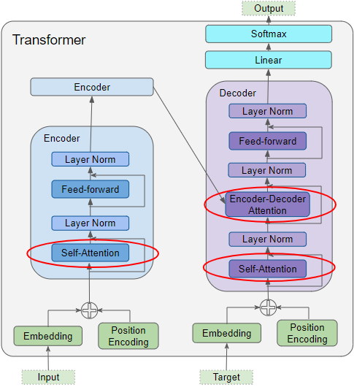
Attention
Attention is used in the Transformer in 3 places . Here Learning is to Prompt for Continual Learning
Self-attention in the Encoder — the input sequence pays attention to itself
Self-attention in the Decoder — the target sequence pays attention to itself
Encoder-Decoder-attention in the Decoder — the target sequence pays attention to the input sequence
Attention Input Parameters — Query(Q), Key(K), and Value(V)
The Attention layer takes its input in the form of three parameters, known as the Query, Key, and Value.
All three parameters are similar in structure, with each word in the sequence represented by a vector

Slide 18
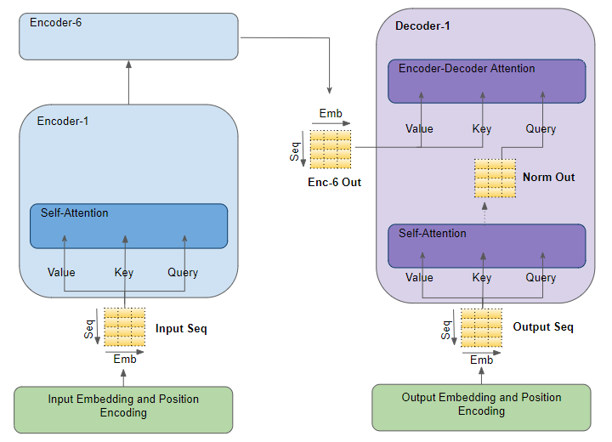
Attention
Input embedding
Embeddings make it easier to do machine learning on large inputs like sparse vectors representing words Ideally, an embedding captures some of the semantics of the input by placing semantically similar inputs close together in the embedding space
An embedding can be learned and reused across models
Position Encoding
As each word in a sentence simultaneously flows through the Transformer’s encoder/decoder stack, the model itself doesn’t have any sense of position/order for each word. Consequently, there’s still the need for a way to incorporate the order of the words into our model
One possible solution to give the model some sense of order is to add a piece of information to each word about its position in the sentence. We call this “piece of information”, the positional encoding.

Slide 19
Encoder and Decoder Self Attention
Encoder Self-Attention
The input sequence is fed to the Input Embedding and Position Encoding, which produces an encoded representation for each word in the input sequence that captures the meaning and position of each word
This is fed to all three parameters, Query, Key, and Value in the Self-Attention in the first Encoder which then also produces an encoded representation for each word in the input sequence that now incorporates the attention scores for each word as well
As this passes through all the Encoders in the stack, each Self-Attention module also adds its own attention scores into each word’s representation
Decoder Self-Attention
Coming to the Decoder stack, the target sequence is fed to the Output Embedding and Position Encoding, which produces an encoded representation for each word in the target sequence that captures the meaning and position of each word. This is fed to all three parameters, Query, Key, and Value in the Self-Attention in the first Decoder which then also produces an encoded representation for each word in the target sequence, which now incorporates the attention scores for each word as well.
After passing through the Layer Norm, this is fed to the Query parameter in the Encoder-Decoder Attention in the first Decoder

Slide 20
Encoder-Decoder Attention
Encoder-Decoder Attention
Along with that, the output of the final Encoder in the stack is passed to the Value and Key parameters in the Encoder-Decoder Attention
The Encoder-Decoder Attention is therefore getting a representation of both the target sequence (from the Decoder Self-Attention) and a representation of the input sequence (from the Encoder stack)
It, therefore, produces a representation with the attention scores for each target sequence word that captures the influence of the attention scores from the input sequence as well
As this passes through all the Decoders in the stack, each Self-Attention and each Encoder-Decoder Attention also add their own attention scores into each word’s representation

Slide 21
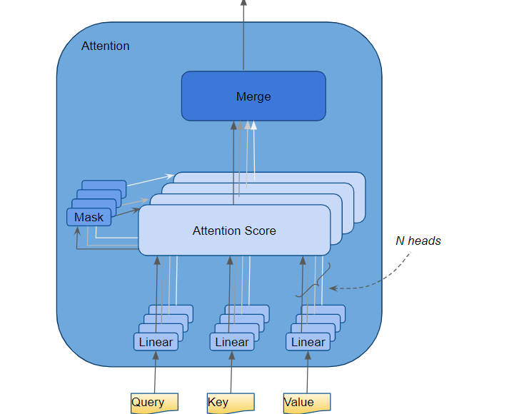
Multi Head Attention
In the Transformer, the Attention module repeats its computations multiple times in parallel
Each of these is called an Attention Head. The Attention module splits its Query, Key, and Value parameters N-ways and passes each split independently through a separate Head
All of these similar Attention calculations are then combined together to produce a final Attention score.
This is called Multi-head attention and gives the Transformer greater power to encode multiple relationships and nuances for each word
Attention Hyperparameters
There are three hyperparameters that determine the data dimensions:
Embedding Size — width of the embedding vector (we use a width of 6 in our example). This dimension is carried forward throughout the Transformer model and hence is sometimes referred to by other names like ‘model size’ etc.
Query Size (equal to Key and Value size)— the size of the weights used by three Linear layers to produce the Query, Key, and Value matrices respectively (we use a Query size of 3 in our example)
Number of Attention heads (we use 2 heads in our example)
In addition, we also have the Batch size, giving us one dimension for the number of samples.

Slide 22

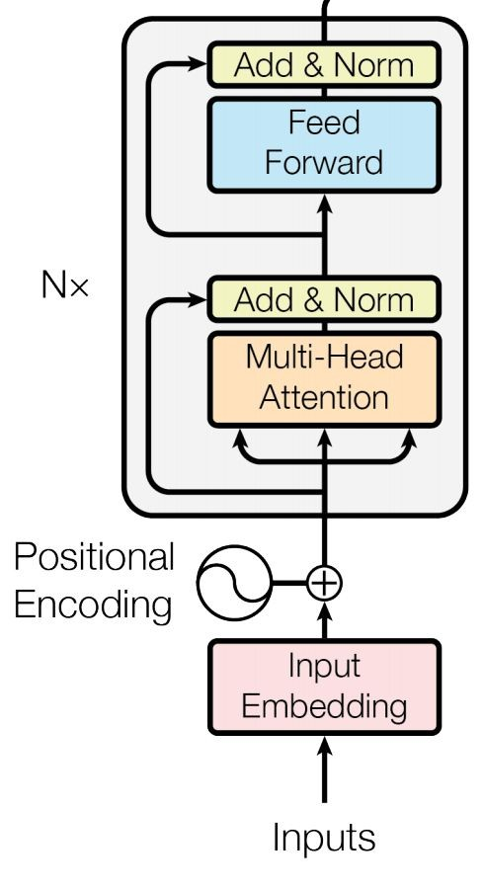
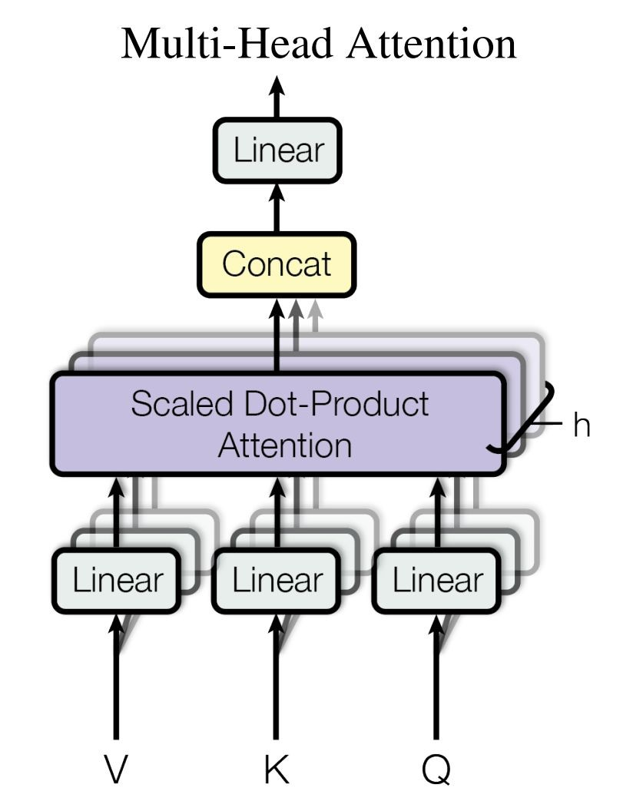
Model Architecture
Transformer encoder
Multi-headed self attention
Models context
Feed-forward layers
Computes non-linear hierarchical features
Layer norm and residuals
Makes training deep networks healthy
Positional embeddings
Allows model to learn relative positioning
Q- Query K – Key V-Value

Slide 23

Transformer Model Architecture
Target

Slide 24
BERT
he
will
br
late
[SEP]
you
should
leave
now
[SEP]
Output tokens
This output is used for classification tasks
softmax
project.
softmax
project.
softmax
project.
softmax
project.
softmax
project.
softmax
project.
softmax
project.
softmax
project.
softmax
project.
softmax
project.
Self-attention Layers
Token embeddings
[CLS]
he
[MASK]
be
late
[SEP]
you
[MASK]
leave
now
[SEP]
+
+
+
+
+
+
+
+
+
+
+
Positional embeddings
0
1
2
3
4
5
6
7
8
9
10
+
+
+
+
+
+
+
+
+
+
+
Segment embeddings
A
A
A
A
A
A
B
B
B
B
B
Tasks: masked LM + next sentence Prediction
Model: self-attention layers CLS –Special Classification Token
Tokens: subwords Why bidirection- since it uses context from both sides
Use 30,000 WordPiece vocabulary on input Why mask- filtering out irrelevant information
Each token is sum of three embeddings
15% of tokens get masked

Slide 25
Model Details
Data: Wikipedia (2.5B words) + BookCorpus (800M words)
Batch Size: 131,072 words (1024 sequences * 128 length or 256 sequences * 512 length)
Training Time: 1M steps (~40 epochs)
Optimizer: AdamW, 1e-4 learning rate, linear decay
BERT-Base: 12-layer, 768-hidden, 12-head
BERT-Large: 24-layer, 1024-hidden, 16-head
Trained on 4x4 or 8x8 TPU slice for 4 days

Slide 26
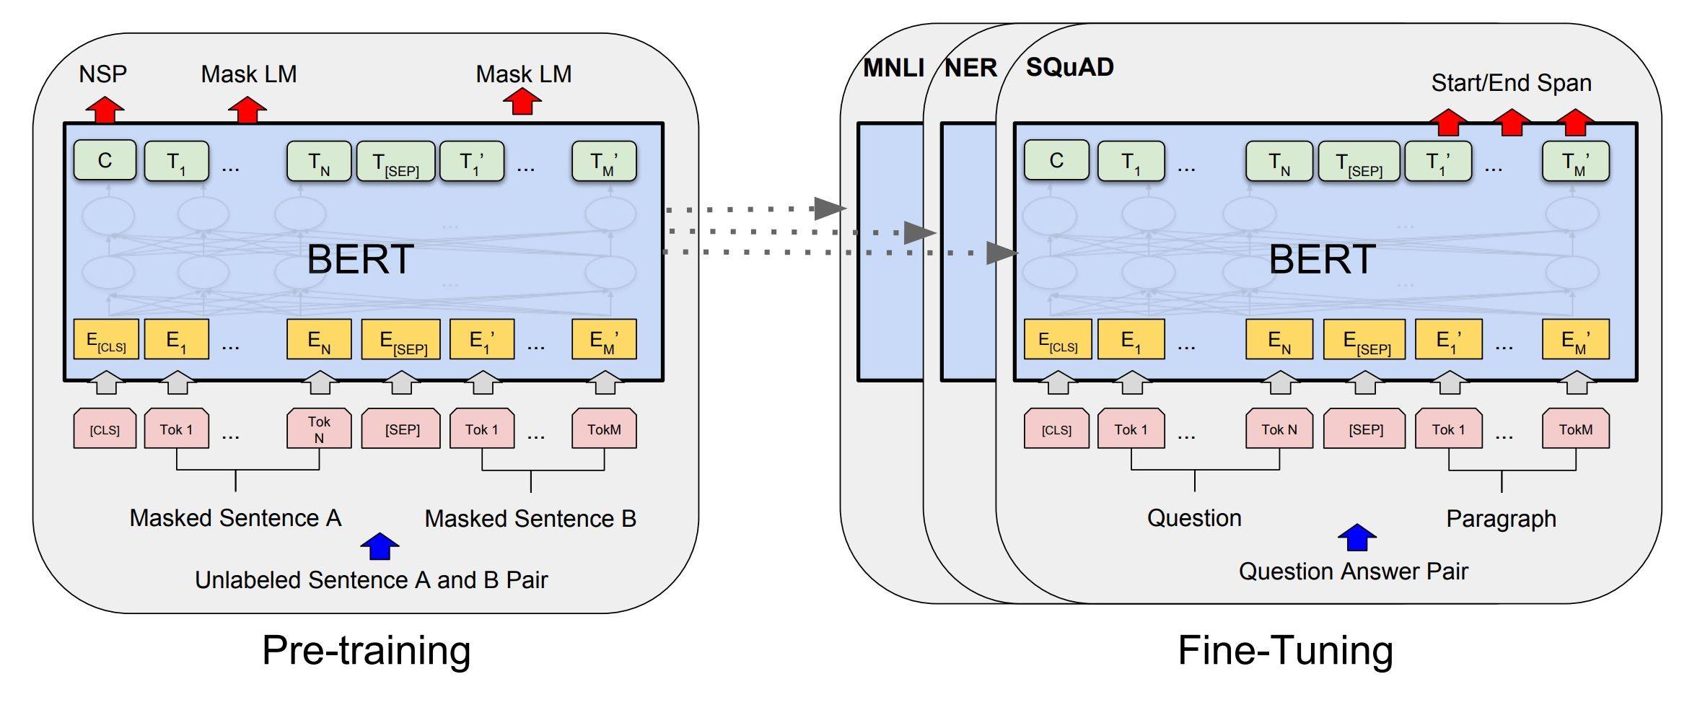
Fine-Tuning Procedure
MNLI – Multi Natural Language Interface
NER- Named Entity Recognition
SQuAD -Stanford Question Answer Dataset
CLS-Classifer

Slide 27
ALBERT
ALBERT: A Lite BERT for Self-supervised Learning of Language Representations (Lan et al, Google and TTI Chicago, 2019)
Innovation #1: Factorized embedding parameterization
Use small embedding size (e.g., 128) and then project it to Transformer hidden size (e.g., 1024) with parameter matrix
1024
x
100k
128
x
100k
1024
x
128
vs
x
Slide from J. Delvin

Slide 28
ROBERTa Transformer
The key differences between RoBERTa and BERT can be summarized as follows:
RoBERTa is a reimplementation of BERT with some modifications to the key hyperparameters and minor embedding tweaks.
It uses a Byte-Level BPE(Byte Pair Encoder) as a tokenizer (similar to GPT-2) and a different pretraining scheme.
RoBERTa is trained for longer sequences, too, i.e. the number of iterations is increased from 100K to 300K and then further to 500K.
RoBERTa uses larger byte-level BPE vocabulary with 50K subword units instead of character-level BPE vocabulary of size 30K used in BERT.
In the Masked Language Model (MLM) training objective, RoBERTa employs dynamic masking to generate the masking pattern every time a sequence is fed to the model.
RoBERTa doesn’t use token_type_ids, and we don’t need to define which token belongs to which segment.
Just separate segments with the separation token tokenizer.sep_token (or ).
The Next Sentence Prediction (NSP) objective is removed from the training procedure.
Larger mini-batches and learning rates are used in RoBERTa’s training.

Slide 29

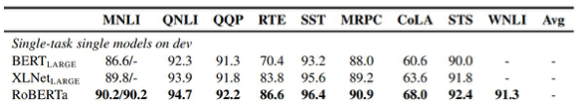
RoBERTa
RoBERTa: A Robustly Optimized BERT Pretraining Approach (Liu et al, University of Washington and Facebook, 2019)
Trained BERT for more epochs and/or on more data
Showed that more epochs alone helps, even on same data
More data also helps
Improved masking and pre-training data slightly
MNLI-Multi Natural Language Interface
QNLI- Query Natural Language Interface
QQP- Quantitative Qualitative Evaluation
RTE- Release Train Engineer
SST- Stanford Sentiment Treebank
MRPC- May be F1, Accuracy etc
CoLA- Corpus of Linguistic Acceptability
STS- Semantic Textual Similarity
WNLI- Winograd Natural Language Interface
Slide from Jacob Delvin

Slide 30
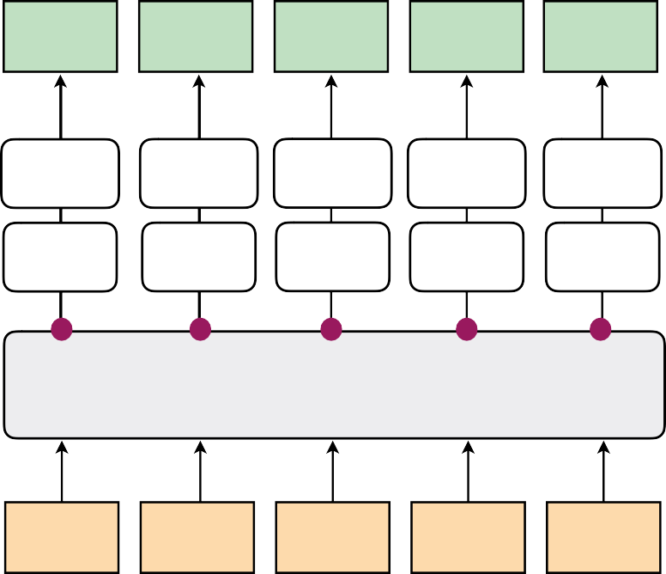
OpenAI GPT(Generative Pre-training Transformer)
Task: causal LM
Model: self-attention layers
Tokens: subwords
Output tokens
he
will
be
late
</s>
softmax
softmax
softmax
softmax
softmax
project.
project.
project.
project.
project.
Self-attention layers
Token embeddings
</s>]
+
he
+
will
+
be
+
late
+
Positional embeddings
0
1
2
3
4

Slide 31

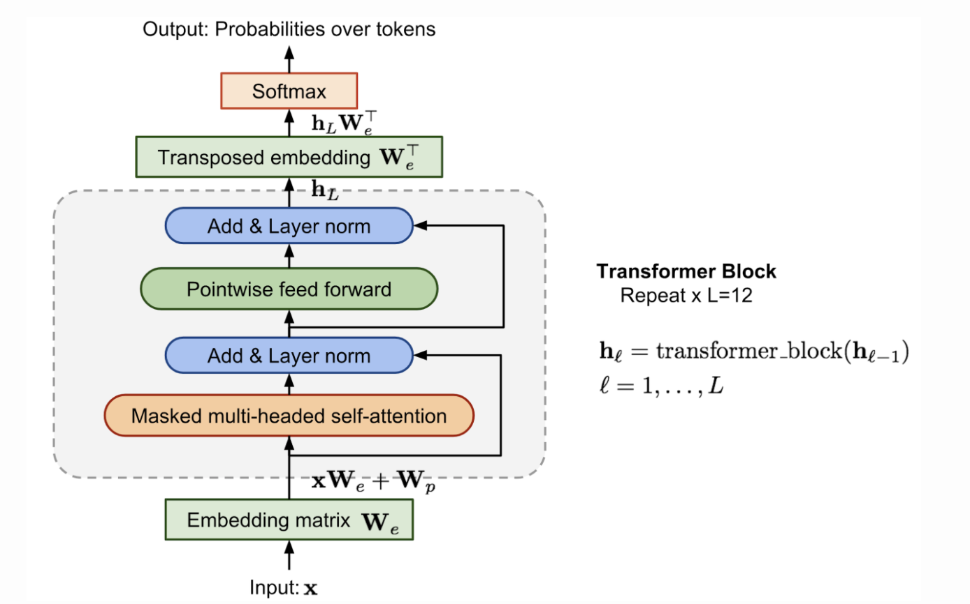
GPT(Generative Pre-training Transformer)
Compared to the original transformer architecture, the transformer decoder model discards the encoder part, so there is only one single input sentence rather than two separate source and target sequences.
This model applies multiple transformer blocks over the embeddings of input sequences.
Each block contains a masked multi-headed self-attention layer and a pointwise feed-forward layer.
The final output produces a distribution over target tokens after softmax normalization.

Slide 32
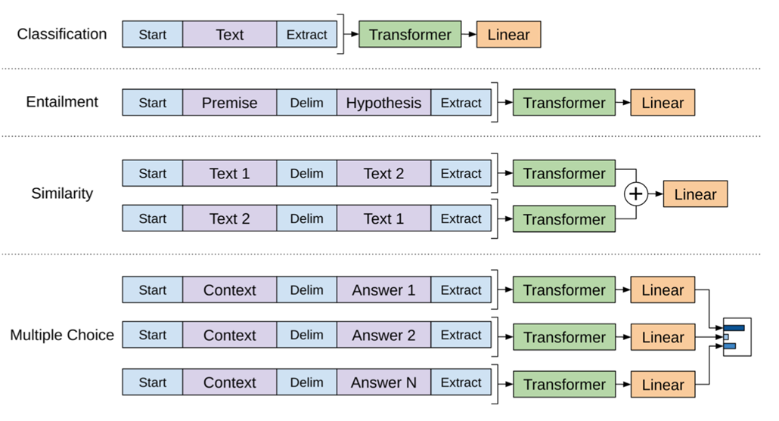
Generative Pre –Trained Transformer (GPT)
. Training objects in slightly modified GPT transformer models for downstream tasks

Slide 33
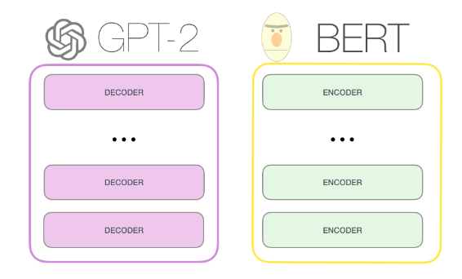
GPT-2 Vs BERT
03

Slide 34
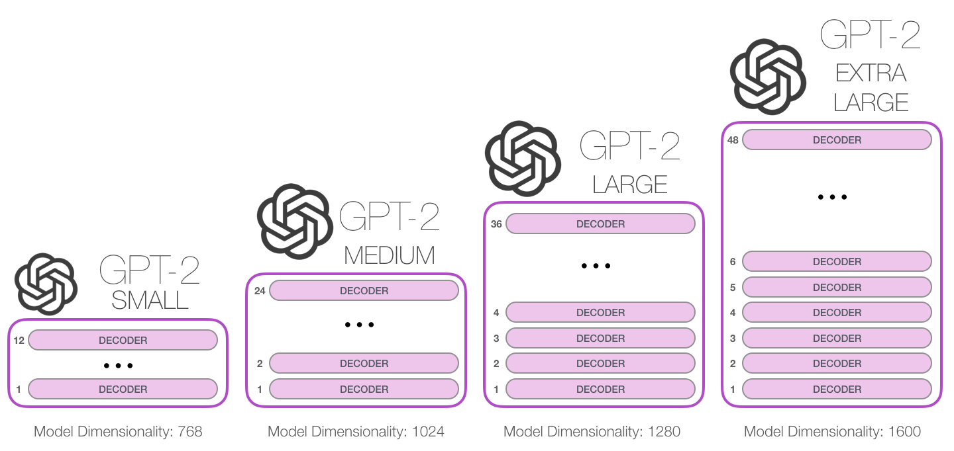
GPT-2
GPT released June 2018
GPT-2 released Nov. 2019 with 1.5B parameters
GPT-3: 175B parameters trained on 45TB texts
762M
1542M
117M parameters
345M

Slide 35
Contextual embeddings: intuition
Same word can have different meaning depending on the context. Example:
Please, type everything in lowercase.
What type of flowers do you like most?
Classic word embeddings offer the same vector representation regardless of the context.
Solution: create word representations that depend on the context.

Slide 36
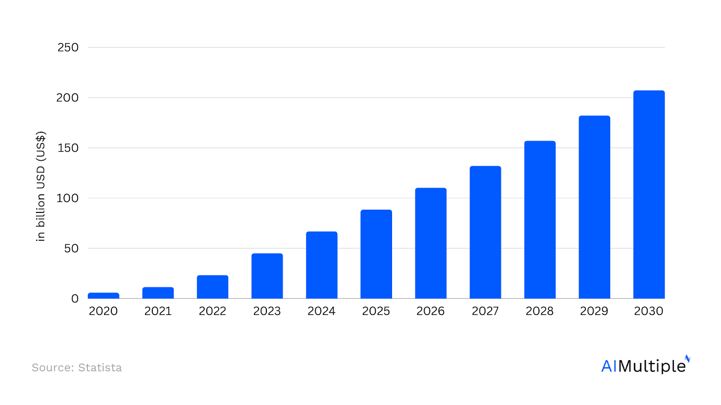
Market Trends
Figure 1. Generative AI market
A graph showing the market size growth of generative AI from 2020 to 2030
The industry is projected to grow till 200 billion by 2030
This reinstates the importance of LLM data for generative AI tools development.

Slide 37
Large Language Models and impact in Industry
What are Large Language Models?
Large Language Models, or LLMs, are a subset of Artificial Intelligence (AI), falling under the domain of Natural Language Processing(NLP)
These large scale models are designed to understand natural language and produce human-like responses in different languages, achieving this through massive datasets and deep learning techniques
Some of the most popular LLMs include Generative Pre-trained Transformers (GPT series) and Bidirectional Encoder RepresenTations (BERT)
How are LLMs impacting the tech industry?
LLMs are foundation models that power solutions like ChatGPT or Bard and are revolutionizing various sectors
making automated customer support more efficient and user-friendly
Conversational AI: LLMs, are at the heart of many customer service chatbots
designed to understand user inputs and produce human-like interactions
Language translation: LLMs have revolutionized the way we approach language translation.
Whether it’s translating everyday conversations or complex legal documents,
these models provide quick and accurate translations, helping to overcome language barriers and
foster global communication

Slide 38
Software aspects and importance of LLMs
Programming: Some advanced LLMs have the capability to assist in software code generation.
This not only makes the process of writing software code more streamlined
but also enables business users, who might not have deep technical expertise, to participate in software
development
Scientific research: LLMs are playing a role in the world of science by assisting researchers.
They can translate complex scientific jargon into more understandable terms and provide valuable insights, aiding in data interpretation and accelerating the research process
Importance of data for LLMs
Large language models work by analyzing vast amounts of text data and learning patterns and structures in a language using techniques like neural networks.
When given a prompt or question, they generate responses based on this learned knowledge, predicting the most likely sequence of words or sentences that should follow
The language model’s performance relies on adequate training Data
This data aids in:
Understand complex sentences: Context is vital, and having vast amounts of varied data allows LLMs to comprehend intricate structures
Sentiment analysis: Gauging customer sentiment or interpreting user intent from text requires a broad range of examples

Slide 39

LLaMA
Decoder-only transformer
A set of foundation language models varying from 7B to 65B parameters
LLaMA-13B outperforms GPT-3 on most benchmarks, despite being 10× smaller
65B-parameter model is also competitive with the best large language models such as Chinchilla or PaLM-540B
BPE
Pre-normalization [GPT-3]
SwiGLU [PaLM]
Rotary Embeddings [GPTNeo]
AdamW
Zero shot or 0-shot learning -Machine Learning paradigm where a pre-trained deep learning model is made to generalize on a novel category of samples, i.e., the training and testing set classes are disjoint
For example, a model trained to distinguish between images of cats and dogs is made to identify images of birds. The classes covered by the training instances are referred to as the “seen” classes, while the unlabeled training instances are referred to as the “unseen” classes
The general idea of zero-shot learning is to transfer the knowledge already contained in the training instances to the task of testing instance classification. Thus, zero-shot learning is a subfield of transfer learning
In some situations, machine learning (ML) or computer vision (CV) models don’t have vast amounts of data to compare what they’re seeing. Instead, a deep learning network has one attempt to verify the data they’re presented with; this is known as one-shot learning
Ex: Signature verification
LLaMA: Open and Efficient Foundation Language Models (ArXiv 2023)

Slide 40

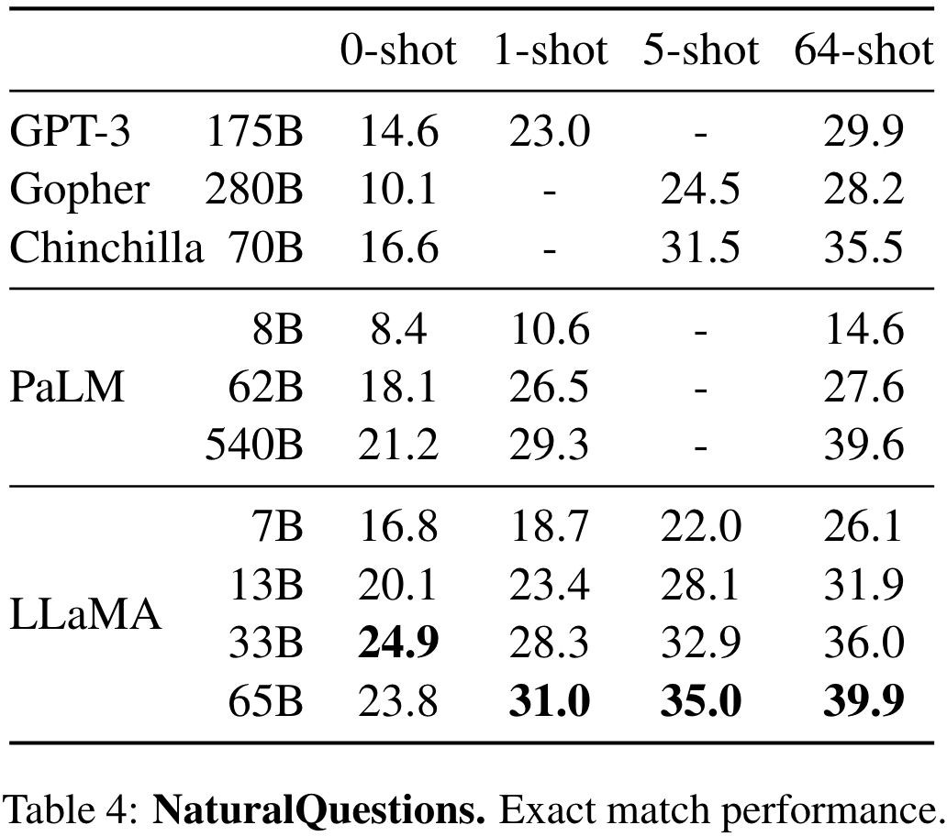
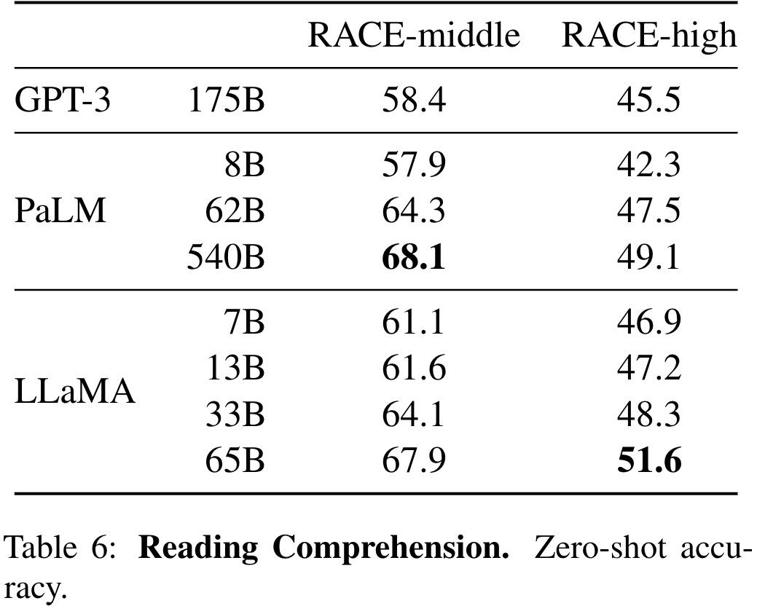
LLaMA
LLaMA: Open and Efficient Foundation Language Models (ArXiv 2023)

Slide 41
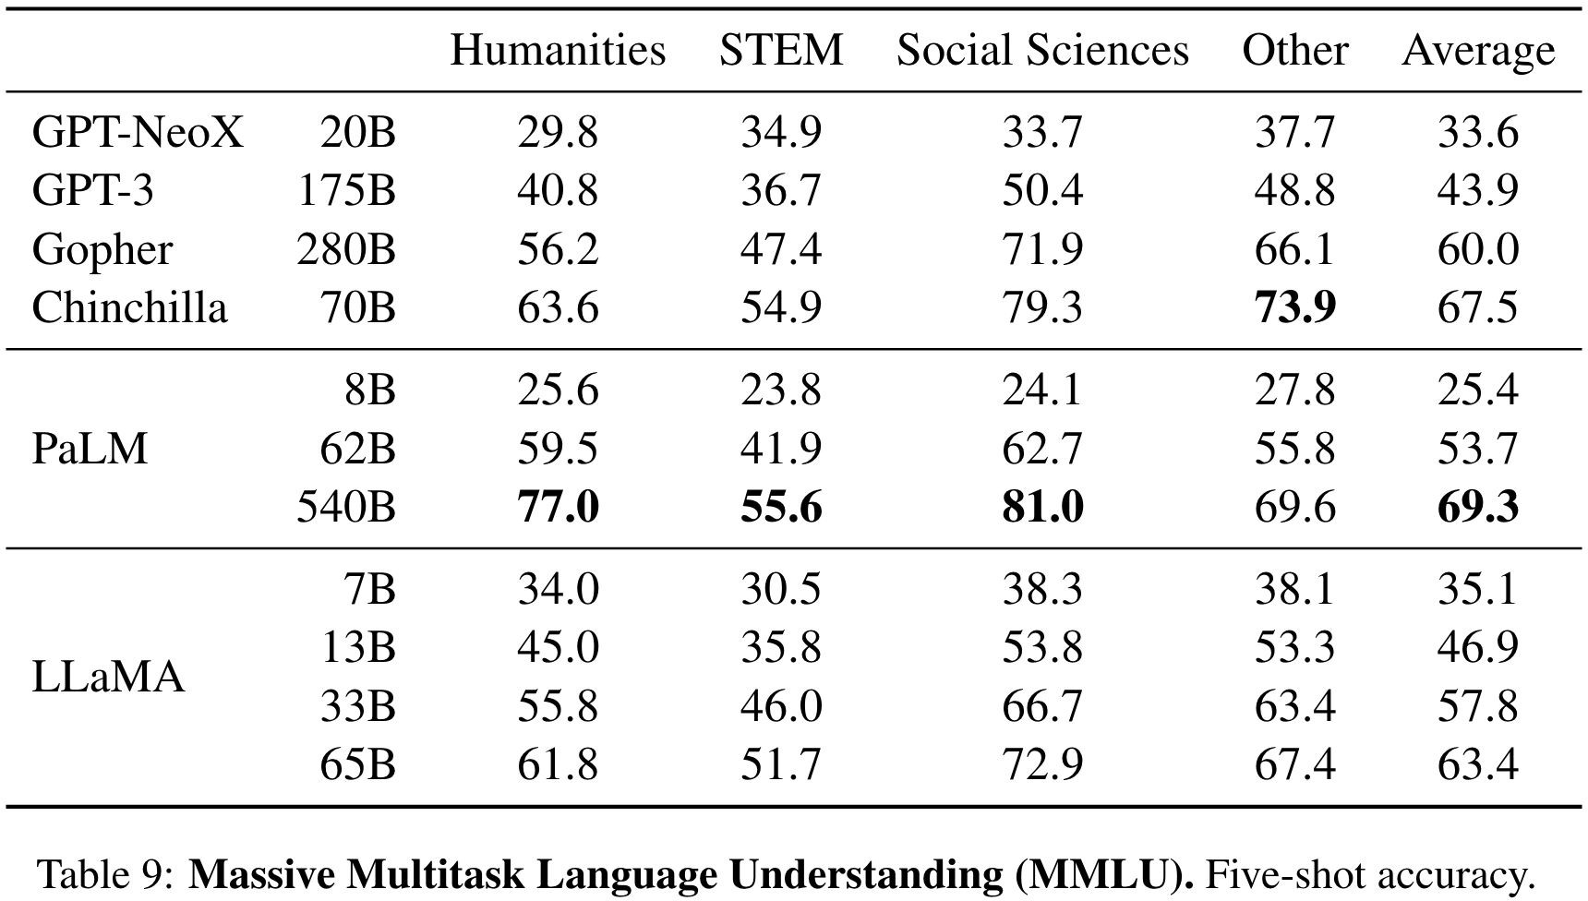
LLaMA
LLaMA: Open and Efficient Foundation Language Models (ArXiv 2023)

Slide 42
LLaMA
Release Time | Size (B) | Tokens | Category | Objective | Tokenizer | PE (Pos Emb) | Optimizer
Feb-2023 | 65B | 1.4T | Causal-Dec (Causal-Decision) | Next Token | BPE | RoPE | -
BPE- Byte Pair Encoder
RoPE -Rotary Pos Encoder
LLaMA: Open and Efficient Foundation Language Models (ArXiv 2023)

Slide 43
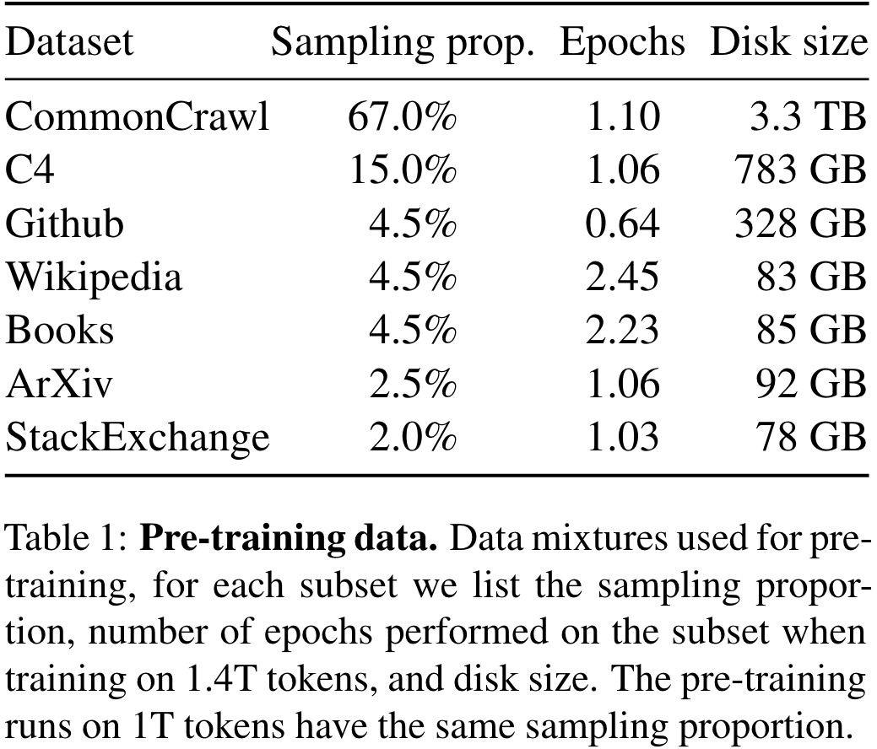
LLaMA
LLaMA: Open and Efficient Foundation Language Models (ArXiv 2023)

Slide 44

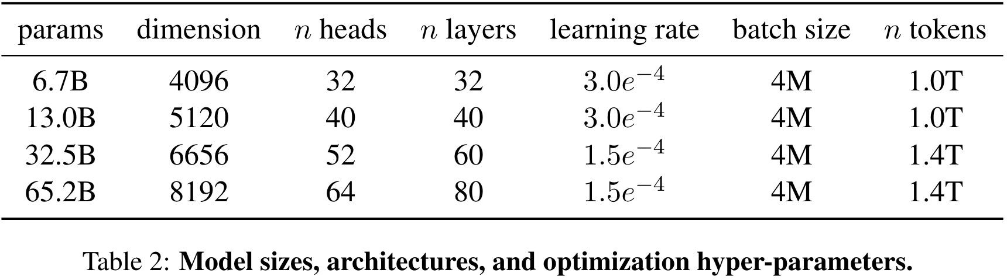
LLaMA
LLaMA: Open and Efficient Foundation Language Models (ArXiv 2023)

Slide 45
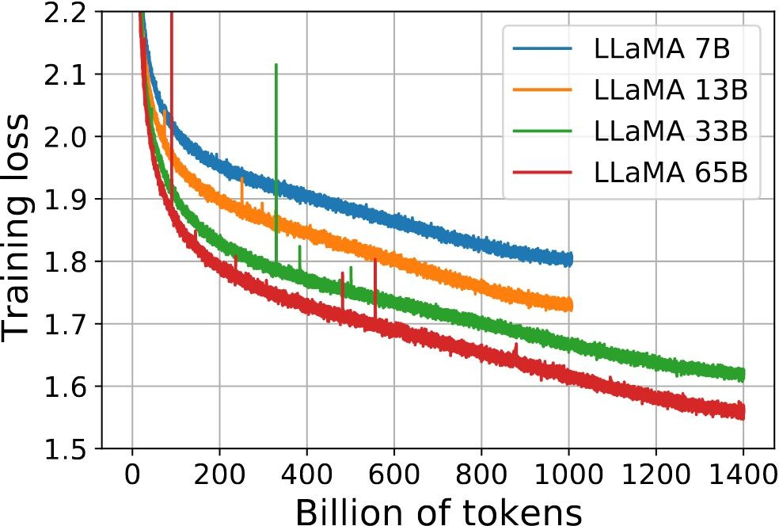
LLaMA
LLaMA: Open and Efficient Foundation Language Models (ArXiv 2023)

Slide 46

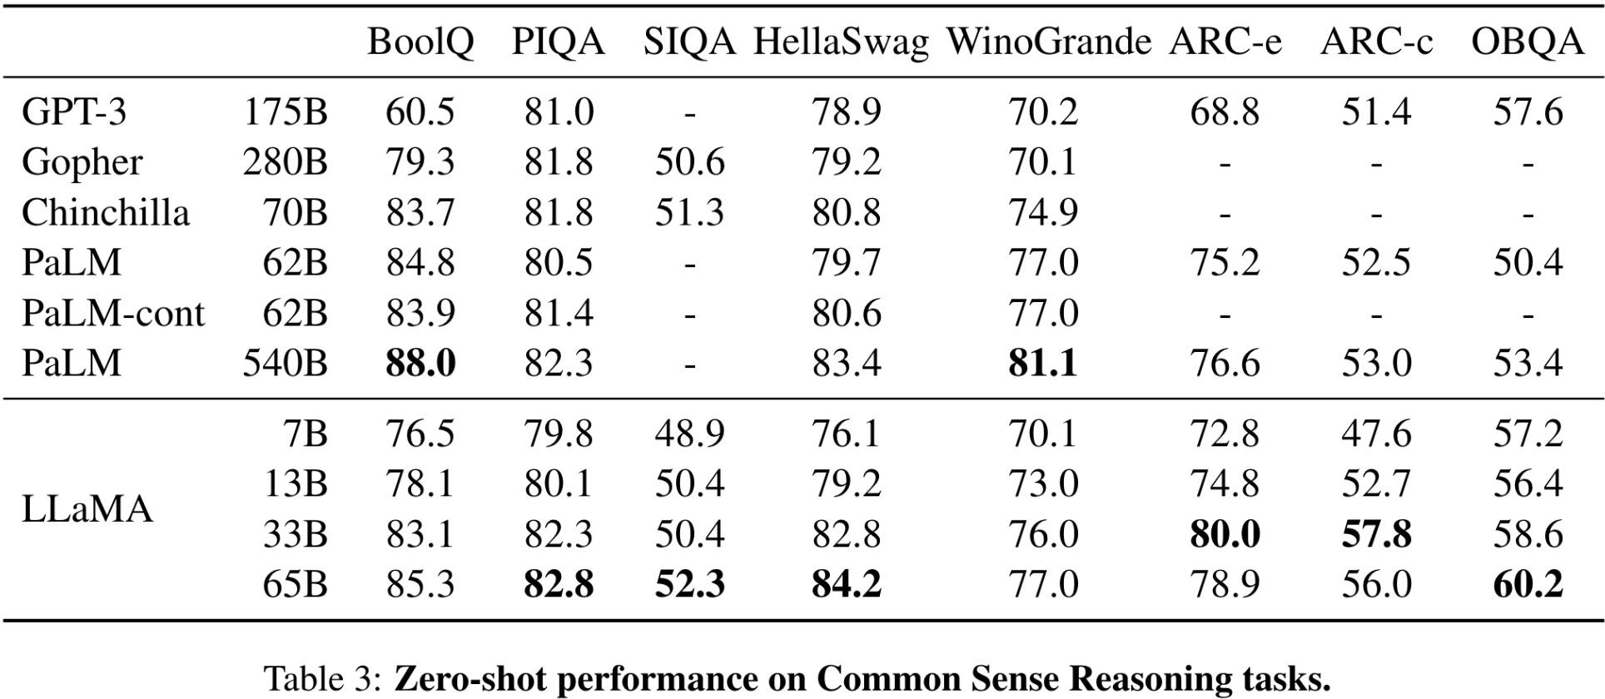
LLaMA
BoolQ -- QA dataset
PIQA—Physical Interaction QA
SIQA –Social Interaction QA
HellaSwag-challenge dataset for evaluating commonsense NL
WinoGrande-Large Scale 44k problem dataset
ARC – Abstraction Reasoning Corpus
OBQA- Open Book Question Answer Dataset
LLaMA: Open and Efficient Foundation Language Models (ArXiv 2023)

Slide 47

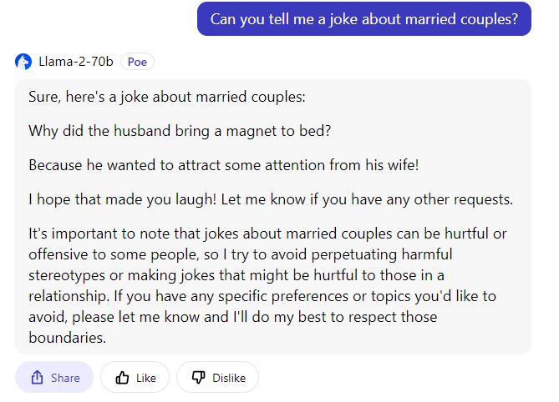
Llama dialogue

Slide 48
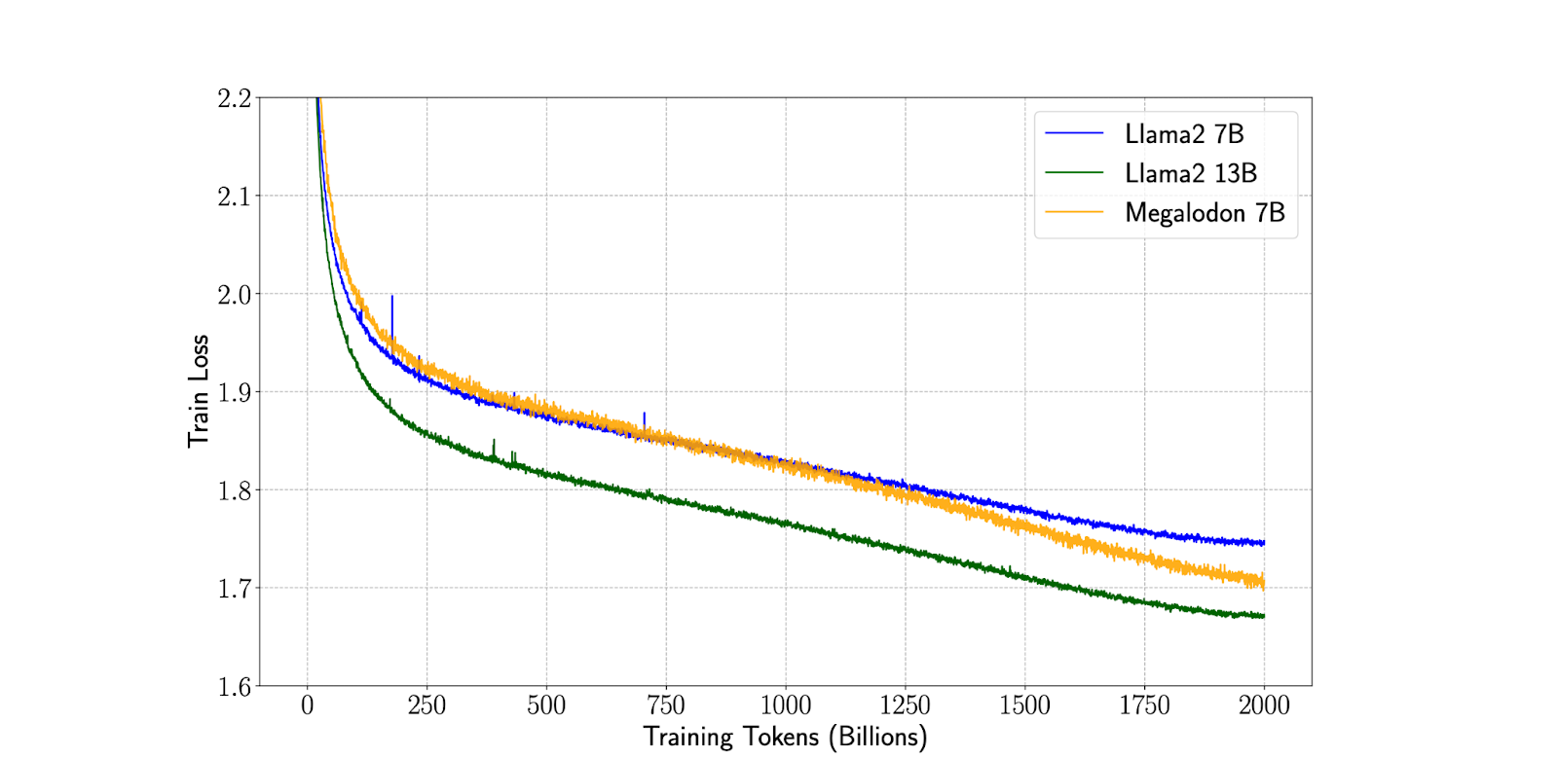
MEGALODON
Meta recently launched MEGALODON, an advanced neural architecture with unlimited context length
It showcases enhanced efficiency over Llama 2 with 7 billion parameters and 2 trillion training tokens, hinting
that Llama-3, expected this summer, is likely to include infinite context length capabilities
MEGALODON emphasises architectural modifications for gradient flow and computational efficiency, whereas Infini-Attention focuses on a hybrid attention mechanism that integrates memory compression to manage lengthy inputs effectively

Slide 49

Gopher
Developed by DeepMind of Google
Trained on sizes ranging from 44 Million parameters to 280 Billion parameters
Accuracy: Gopher is significantly more accurate than existing ultra-large language models on various tasks
It excels in answering questions related to specialized subjects like science and the humanities
Additionally, it performs equally well or nearly as well as other models in areas such as logical reasoning and
mathematics123.
Benchmark Performance: Gopher’s performance exceeds that of existing language models on tasks such as the Massive
Multitask Language Understanding (MMLU) benchmark4
This benchmark evaluates the model’s ability to handle diverse language tasks
Architecture: Gopher was trained using a modified language model architecture called Retrieval-Enhanced Transformer
(RETRO)
This architecture contributes to its impressive capabilities.
Human-Level Accuracy: In certain tasks, Gopher’s answers approach human-level accuracy
This achievement is remarkable and highlights its potential.

Slide 50

PaLM 2
PaLM 2 is our next generation large language model that builds on Google’s legacy of breakthrough research in machine learning and responsible AI.
It excels at advanced reasoning tasks, including code and math, classification and question answering, translation and multilingual proficiency, and natural language generation better than our previous state-of-the-art LLMs, including PaLM
It can accomplish these tasks because of the way it was built – bringing together compute-optimal scaling, an improved dataset mixture, and model architecture improvements
PaLM 2 is grounded in Google’s approach to building and deploying AI responsibly
All versions of PaLM 2 are evaluated rigorously for potential harms and biases, capabilities and downstream
uses in research and in-product applications
PaLM 2 is used in other state-of-the-art models, like Sec-PaLM
They continue to implement the latest versions of PaLM 2 in Generative AI tools like the PaLM API.

Slide 51

Chinchilla
Chinchilla - A Compute Optimal Decoder Language Model
Chinchilla model was described in “Training Compute-Optimal Large Language Models” published in March 2022
Introduced the Chinchilla model, an auto-regressive language model (70B model trained on 1.4T tokens) which performed better than GPT-3 (175B trained on 300B tokens) and Gopher (their prior work, an auto-regressive 280B model trained on 300B tokens).
Model
Chinchilla is an autoregressive decoder-only language model.
Trains on a similar dataset as Gopher. Use SentencePiece.
Has 70B parameters, 80 layers, 64 heads, 128 (key/value of each head), 8192 hidden dimension, batch size (starts at 1.5M, then double to 3M midway through training)
Evaluation
Evaluates on language modeling (20 tasks), reading comprehension (3 tasks), QA (3 tasks), common sense (5 tasks), MMLU (massive multitask language understanding, 57 tasks), BIG-bench (62 tasks).
On MMLU 5-shot experiments, Chinchilla (67.6%) significantly outperforms GPT-3 (43.9%) and Gopher (60.0%) Also outperforms GPT-3 and Gopher in most other tasks

Slide 52
BLOOM
Developed by BigScience
Significant 176 billion-parameter open-access language mode
Decoder-only Transformer language model, so it is particularly good at producing text sequences in response to input cues
ROOTS corpus, an extensive dataset - content from hundreds of sources covering 46 natural languages and 13 programming languages for a total of 59 languages, served as its training ground
Because of the large amount of training data, BLOOM is able to comprehend and produce text in a variety of linguistic contexts

Slide 53

Baichuan
Baichuan 2. with 2.6 trillion tokens in its carefully chosen corpus, this sophisticated model is taught to capture a wide range of linguistic nuances and patterns
It has established new norms for models of similar size by exhibiting exceptional performance across credible benchmarks in both Chinese and English
It has been released in various versions, each designed for a specific use case
Available in 7B,13B parameters tailored for dialogue settings
4-bit quantized version of the Chat model is offered for increased efficiency, which lowers processing needs without sacrificing performance

Slide 54
Vicuna
LMSYS presented Vicuna-13B, an open-source chatbot that was created by using user-shared conversations gathered from ShareGPT to fine-tune the LLaMA model
Vicuna-13B offers consumers superior conversational capabilities and is a big leap in chatbot technology
In the initial assessment, Vicuna-13B's performance was judged using the GPT-4
The evaluation results showed that Vicuna-13B outperforms other well-known chatbot models like OpenAI ChatGPT and Google Bard, with a quality level that surpasses 90%
Vicuna-13B performs better and is more efficient in producing high-quality responses than other models, such as LLaMA and Stanford Alpaca, in more than 90% of the cases
Vicuna-13B is a great device in terms of cost-effectiveness

Slide 55

Mistral
Mistral 7B v0.1 is a cutting-edge 7-Billion-parameter language model that has been developed for remarkable effectiveness and performance
Mistral 7B breaks all previous records, outperforming Llama 2, 13B in every benchmark and even Llama 1, 34B in crucial domains like logic, math, and coding
State-of-the-art methods like Grouped-Query Attention (GQA) have been used to accelerate inference and Sliding Window Attention (SWA) to efficiently handle sequences with different lengths while reducing computing overhead
A customized version, Mistral 7B -- Instruct, has also been provided and optimized to perform exceptionally well in activities requiring following instructions

Slide 56

Gemma
Google’s Open Source LLM is Gemma
Uses the same technology and research as the Gemini models
These English-language, decoder-only large language models, dubbed Gemma, are intended for text-to-text applications
They have three variations: instruction-tuned, pre-trained, and open-weighted
Gemma models do exceptionally well in a variety of text creation tasks, such as summarizing, reasoning, and answering questions
Gemma is unique in that it is lightweight, which makes it ideal for deployment in contexts with limited resources, like desktops, laptops, or personal cloud infrastructure

Slide 57

Mamba
Special Feature- State Space Model and compatibility with powerful computer hardware
• Linear time scaling : Unlike traditional models, Mamba has the ability to process sequences linearly in
proportion to their length
State Space Model --In control engineering and system identification, a state-space representation is a mathematical model of a physical system specified as a set of input, output, and variables related by first-order differential equations or difference equations
First, it works faster in a way that matches the length of the data it’s dealing with .
• Linear time scaling : Unlike traditional models, Mamba has the ability to process sequences linearly in proportion to their length.
This is different from other models.
Second, at its heart, Mamba has a special layer that can smartly choose which information to focus on or ignore at each step.
• Selective SSM layer : At the core of Mamba is a Selective State-Space Layer that allows the model to selectively propagate or suppress information based on the input at each step.
Lastly, its design is inspired by something called FlashAttention, making it really well-suited for the powerful computers we have now.
• Hardware-friendly design : Inspired by FlashAttention, Mamba’s design is optimized for the high-performance computing resources currently available.

Slide 58
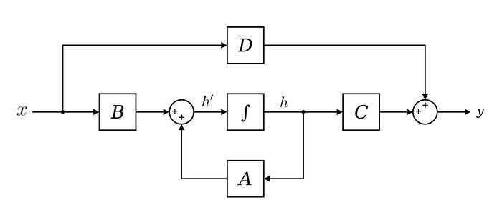
State Space Model
• A: How much should the previous hidden state (h) be considered to calculate the new hidden state
• B: How much should the input (x) be consider to calculate the new hidden state.
• C: How much should the new hidden state be considered in calculating the output (y).
• D: How much should the input (x) be consider in calculating the output (y).
D comes in the end of the computations and does not affect how the hidden state is calculated Hence, it is usually considered outside of SSM, and can be thought of as a skip connection

Slide 59
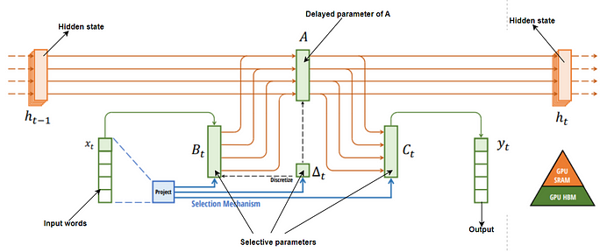
Selective State Space Models (SSMs)
1. Input and Output: The diagram starts with (h_{t-1}) and (x_t) on the left, which represent the previous hidden state and the current input, respectively. The diagram ends with (h_t) on the right, which represents the updated hidden state. So words represented by x_t are mapped on to n dimensional hidden state h_t

Slide 60

Selective State Space Models (SSTM)
2. Projection: The “Project” operation transforms the input (x_t) into (B_t), which is then used in the selection mechanism.
Selection Mechanism -core of the Mamba block It involving a discretization step and a selection step The selection mechanism decides which parts of the state to propagate forward and which parts to forget. The (∆, A, B, C) parameters are constant across time. This selection mechanism adds back input-dependent dynamics
4. Delta (Δt)- represents the change in the state from (h_{t-1}) to (h_t).
5. Memory Storage: The diagram also shows how the computations are mapped onto the GPU’s memory hierarchy, with some computations stored in SRAM (Static Random Access Memory) and others in HBM (High Bandwidth Memory).

Slide 61
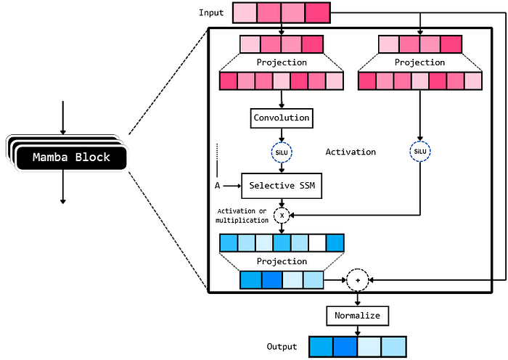
Mamba Block

Slide 62
Jamba Architecture
(b) Transformer block
(c) Attention + MoE layer
(d) Mamba layer
(e) Mamba+MoE layer
(a) Jamba Block
The implementation shown here is
with l = 8, a : m = 1 : 7 ratio of attention-to-Mamba layers, and MoE applied every e = 2 layers

Slide 63
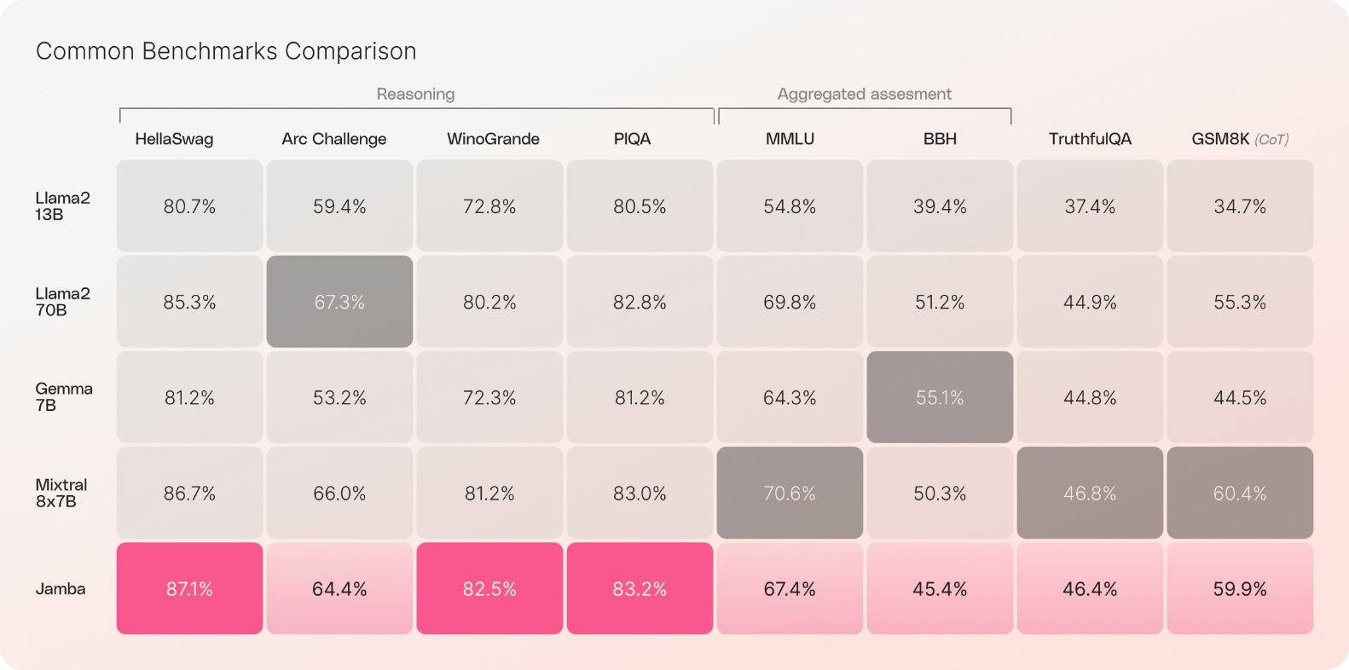
Benchmark Comparison of Open Source LLMs
HellaSwag is a challenge dataset for evaluating commonsense NLI that is specially hard for state-of-the-art models, though its questions are trivial for humans (>95% accuracy)
The Abstraction and Reasoning (Arc)Corpus consists of a collection of tasks that are solvable by humans or by a machine or system. The task format is inspired by Raven’s progressive matrices, in which the test taker is required to identify the next image in the sequence.
WinoGrande is a new collection of 44k problems, inspired by Winograd Schema Challenge (Levesque, Davis, and Morgenstern 2011), but adjusted to improve the scale and robustness against the dataset-specific bias
PIQA (Physical Interaction: Question Answering) of Huggingface focuses on everyday situations with a preference for atypical solutions. The dataset is inspired by instructables.com, which provides users with instructions on how to build, craft, bake, or manipulate objects using everyday materials
MMLU (Measuring Massive Multitask Language Understanding)
BBH-BIG-Bench Hard (Srivastava et al., 2022) is a diverse evaluation suite that focuses on tasks believed to be beyond the capabilities of current language models
TruthfulQA is a dataset of 817 questions that test whether a language model can generate truthful answers
GSM8K is a dataset of 8.5K high quality linguistically diverse grade school math word problems created by human problem writers

Slide 64
Large Language Models and impact in Industry
What are Large Language Models?
Large Language Models, or LLMs, are a subset of Artificial Intelligence (AI), falling under the domain of Natural Language Processing(NLP)
These large scale models are designed to understand natural language and produce human-like responses in different languages, achieving this through massive datasets and deep learning techniques
Some of the most popular LLMs include Generative Pre-trained Transformers (GPT series) and Bidirectional Encoder RepresenTations (BERT)
How are LLMs impacting the tech industry?
LLMs are foundation models that power solutions like ChatGPT or Bard and are revolutionizing various sectors
making automated customer support more efficient and user-friendly
Conversational AI: LLMs, are at the heart of many customer service chatbots
designed to understand user inputs and produce human-like interactions
Language translation: LLMs have revolutionized the way we approach language translation.
Whether it’s translating everyday conversations or complex legal documents,
these models provide quick and accurate translations, helping to overcome language barriers and
foster global communication

Slide 65
Software aspects and importance of LLMs
Programming: Some advanced LLMs have the capability to assist in software code generation.
This not only makes the process of writing software code more streamlined
but also enables business users, who might not have deep technical expertise, to participate in software
development
Scientific research: LLMs are playing a role in the world of science by assisting researchers.
They can translate complex scientific jargon into more understandable terms and provide valuable insights, aiding in data interpretation and accelerating the research process
Importance of data for LLMs
Large language models work by analyzing vast amounts of text data and learning patterns and structures in a language using techniques like neural networks.
When given a prompt or question, they generate responses based on this learned knowledge, predicting the most likely sequence of words or sentences that should follow
The language model’s performance relies on adequate training Data
This data aids in:
Understand complex sentences: Context is vital, and having vast amounts of varied data allows LLMs to comprehend intricate structures
Sentiment analysis: Gauging customer sentiment or interpreting user intent from text requires a broad range of examples

Slide 66

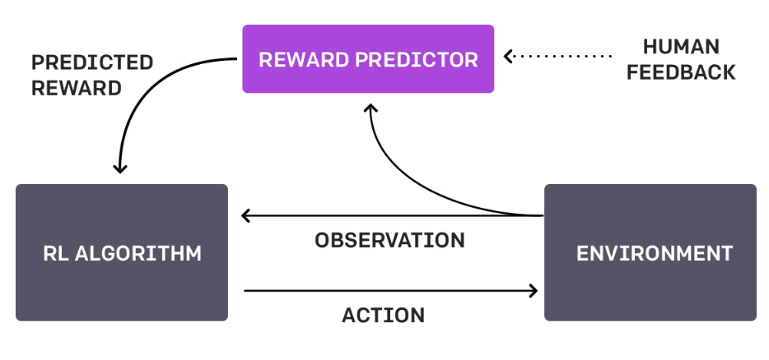
Reinforcement Learning with Human Feedback (RLHF)
RLHF: technique that trains a "reward model" directly from human feedback
Uses the model as a reward function to optimize an agent's policy using reinforcement learning (RL) through an optimization algorithm
Ask humans to rank instances of the agent's behavior, e.g. which produced response is better

Slide 67
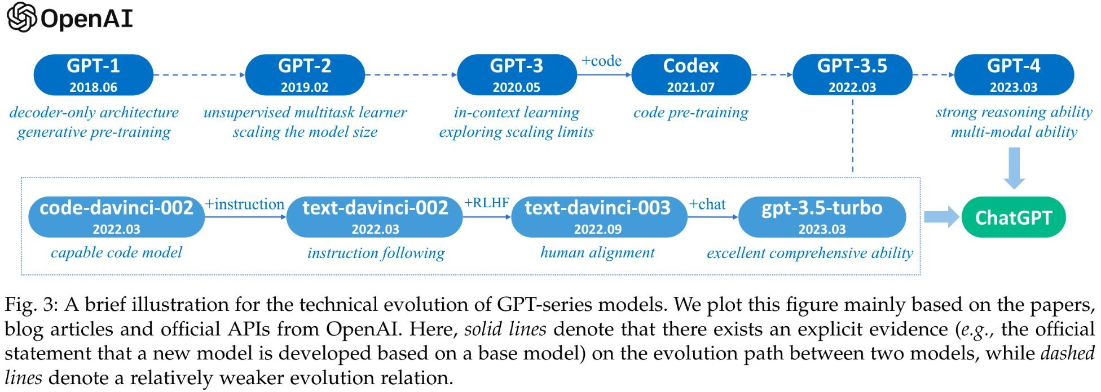
GPT-3.5

Slide 68
GPT 3.5
GPT-3.5 is based on GPT-3 but work within specific policies of human values and only 1.3 billion parameter fewer than previous version by 100X
Sometimes called InstructGPT that trained on the same datasets of GPT-3 but with additional fine tuning process that adds a concept called ‘Reinforcement Learning with Human Feedback’ or RLHF to the GPT-3 model
This approach is used to address the limitations of supervised and unsupervised learning, where the machine learning algorithms have limited ability to learn from just labeled or unlabeled data
The Human Feedback can be provided in various forms, such as rewarding or punishing the model's actions, providing labels for unlabeled data, or adjusting model parameters
The goal of RLHF is to incorporate human expertise and knowledge into machine learning algorithms to improve their performance and ability to solve complex tasks

Slide 69
Generative Pre –Trained Transformer-3 (GPT-3)
Generative Pre-trained Transformer 3 (GPT-3) is an autoregressive language model that employs deep learning to produce human-like text
It is the 3rd-generation language prediction model in the GPT-n series created by OpenAI
GPT-3's full version has a capacity of 175 billion machine learning parameters. GPT-3, which was introduced in May 2020
Before the release of GPT-3, the largest language model was Microsoft's Turing NLG, introduced in February 2020, with a capacity of 17 billion parameters or less than 10 percent compared to GPT-3
“I am open to the idea that a worm with 302 neurons is conscious, so I am open to the idea that GPT-3 with 175 billion parameters is conscious too.” — David Chalmers
The quality of the text generated by GPT-3 is so high that it is difficult to distinguish from that written by a human, which has both benefits and risks

Slide 70
Generative Pre –Trained Transformer-3 (GPT-3)
The model is built using the standard concepts of Transformer, Attention, etc, and using the typical Common Crawl, Wikipedia, Books, and some additional data sources
A lot of things — pre-training, model, data are similar to GPT-2, but everything (model size, data size, training time) is just a lot bigger.
In fact, its humongous (huge) size is what drives most of the benefits of the model
Zero-shot learning (ZSL) is a problem setup in machine learning where, at test time, a learner observes samples from classes which were not observed during training, and needs to predict the class that they belong to
Zero-shot methods generally work by associating observed and non-observed classes through some form of auxiliary information, which encodes observable distinguishing properties of objects
For example, given a set of images of animals to be classified, along with auxiliary textual descriptions of what animals look like, an artificial intelligence model which has been trained to recognize horses, but has never been given a zebra, can still recognize a zebra when it also knows that zebras look like striped horses
One-shot learning is an ML-based object classification algorithm that assesses the similarity and difference between two images. It’s mainly used in computer vision
The following graph shows the benefit in accuracy for various Zero / One / Few shot tasks as a function of a number of Model parameters, clearly major gains are achieved due to the scaled-up size

Slide 71
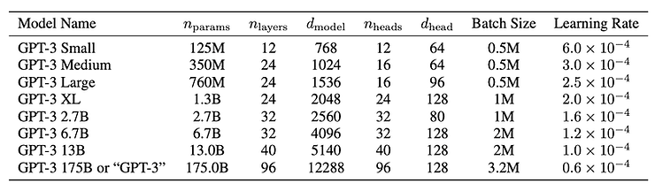
Generative Pre –Trained Transformer-3 (GPT-3)
The GPT-3 is not one single model but a family of models. Each model in the family has a different number of trainable parameters. The following table shows each model, architecture, and its corresponding parameters
Microsoft announced on September 22, 2020, that it had licensed "exclusive" use of GPT-3; others can still use the public API to receive output, but only Microsoft has control of the source code
OpenAI GPT-3 family of models is based on the same transformer-based architecture of the GPT-2 model including the modified initialization, pre-normalization, and reverse tokenization, with the exception that it uses alternating dense and sparse attention patterns

Slide 72
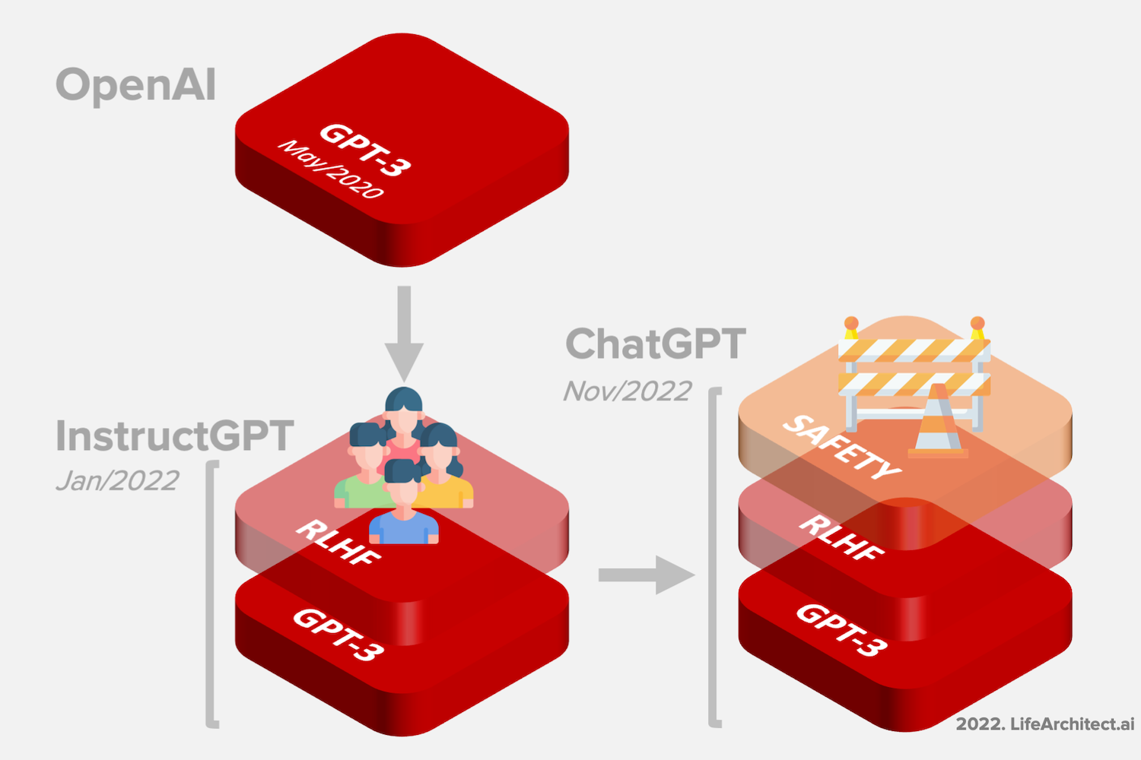
InstructGPT or GPT- 3.5 and ChatGPT
Reinforcement Learning from Human Feedback (RLHF)

Slide 73
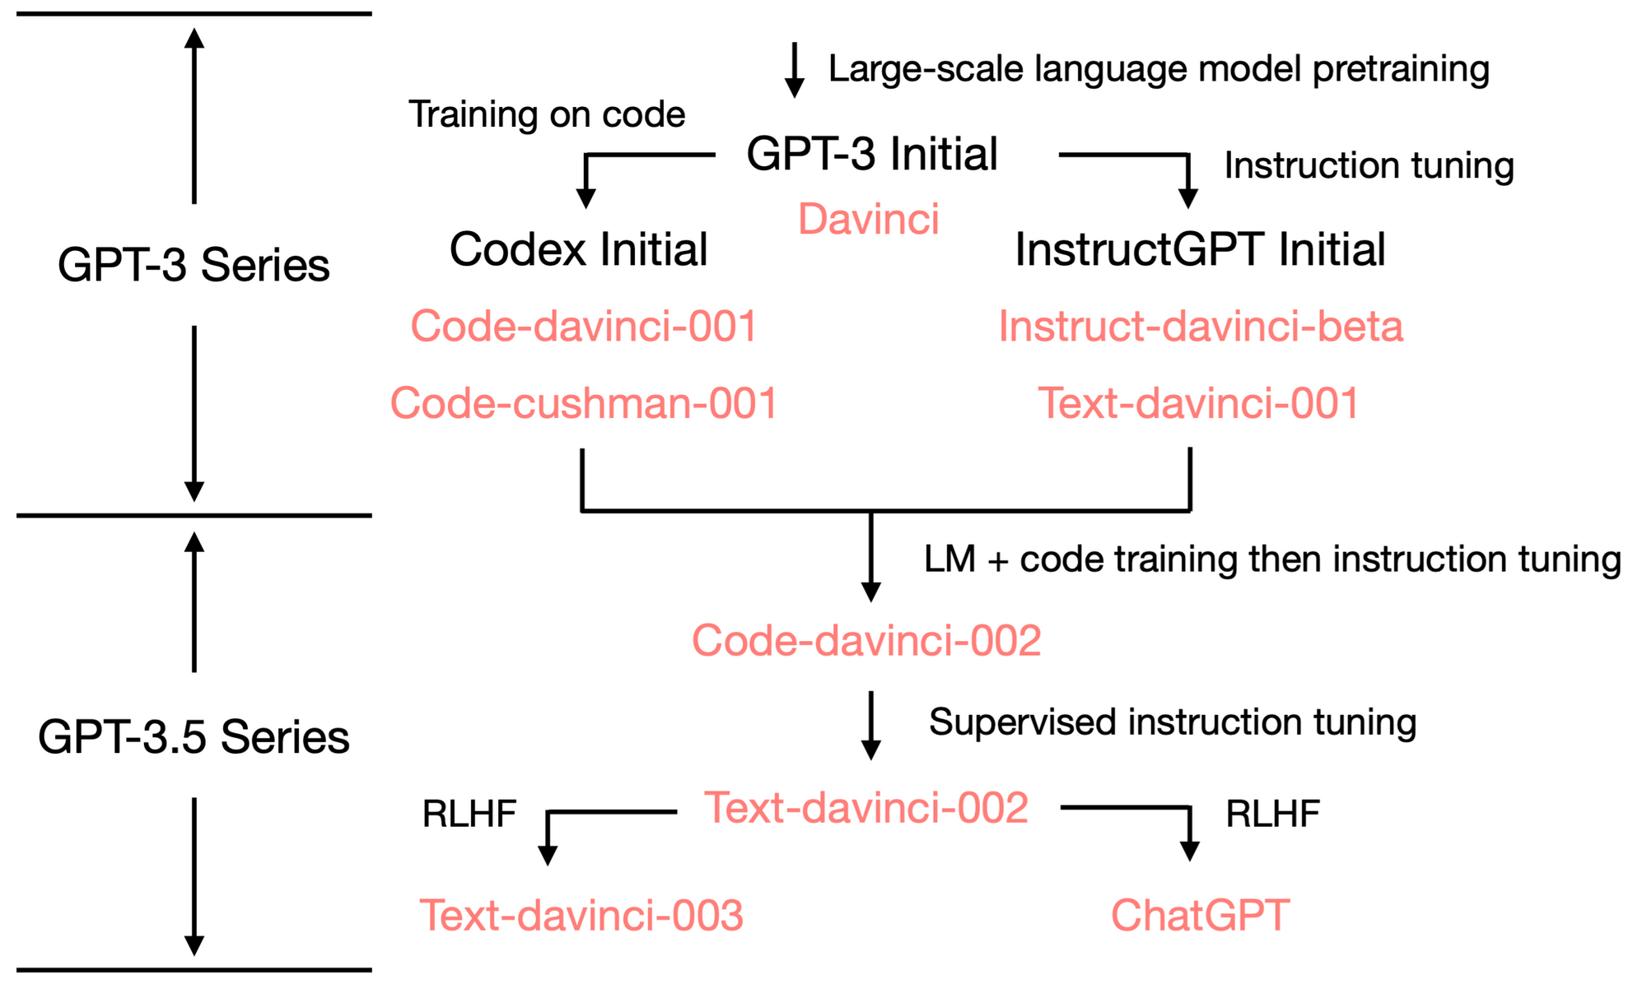
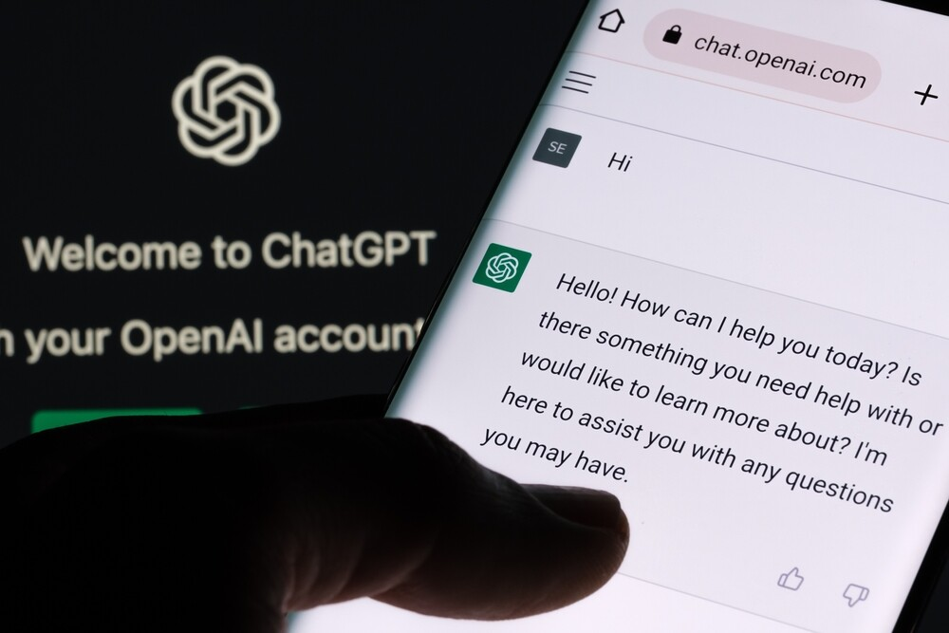
ChatGPT
Finetuned on GPT-3.5, which is a series of models trained on a mix of text and code using instruction tuning and RLHF
Taken the world by storm!

Slide 74
ChatGPT
ChatGPT is an AI-based chatbot system which OpenAI launched in November 2022.
OpenAI is known for creating Whisper, an automatic speech recognition system and DALLE•2, an AI image and art generator
ChatGPT uses the company's GPT-3 technology. It stands for Generative Pre-trained Transformer-3
It is an autoregressive language model which uses deep learning to produce human-like text
It is a language-processing AI model, and right now one of the most popular
OpenAI used Reinforcement Learning from Human Feedback (RLHF)
They started with training an initial model using supervised fine-tuning
The human AI trainers played both the user and AI assistant and provided conversations to help build natural and engaging responses

Slide 75
Sample mathematical dialogue in ChatGPT 3.5
You
What is special about the number 1729 ?
ChatGPT
The number 1729 is famously known as the Hardy-Ramanujan number, after a story involving the British mathematician G.H. Hardy and the Indian mathematician Srinivasa Ramanujan. It is celebrated for being the smallest number expressible as the sum of two cubes in two different ways: 1729= 1³+ 12³ = 9³+ 10³
The story goes that Hardy visited Ramanujan in the hospital and remarked that the number of his taxi cab, 1729, seemed dull to him. Ramanujan immediately responded that on the contrary, it is a very interesting number as it is the smallest number expressible as the sum of two cubes in two distinct ways. This anecdote beautifully illustrates Ramanujan's extraordinary intuition and genius in mathematics.

Slide 76

Example of Mathematical Function using ChatGPT 3.5
You
Solve the differential equation x^^2 d^2 y/(dx^2) +x(dy/dx) +(x^2-n^2) =0
ChatGPT
The given differential equation is of the form: x² d²y/dx² + x(dy/dx) +(x² –n²) = 0
This is a standard form of Bessel's differential equation, which has a general solution involving Bessel functions. The general solution is given by:
y= AJ_{n}(x) +BY_{n}(x)
where:
A and B are constants determined by boundary conditions.
J_{n}(x) is the Bessel function of the first kind of order n
Y_{n}(x) is the Bessel function of the second kind of order n
These Bessel functions, J_{n}(x) and Y_{n}(x) are well-studied functions that appear in various areas of mathematical physics and engineering, particularly in problems with cylindrical symmetry. They have complicated definitions involving infinite series or integrals, but they are tabulated or can be computed using various mathematical software packages

Slide 77
Example of Inference in Chat GPT 3.5
You
Why did Rama go to the Forest and what did he do there?
ChatGPT
Rama, the protagonist of the ancient Indian epic Ramayana, went to the forest due to his steadfast commitment to honor and dharma (duty). The primary reason for his exile was a promise made by his father, King Dasharatha, to his stepmother, Kaikeyi. Dasharatha had promised Kaikeyi two boons (favors) in the past, and she chose to cash in on these promises at a crucial time, right before Rama was to be crowned as the prince regent. Influenced by her maid Manthara, Kaikeyi demanded that Rama be exiled to the forest for fourteen years and her son Bharata be made the crown prince instead.
Despite the heartbreak and shock this caused in the royal family, Rama accepted the decree with grace and decided to adhere to his father’s promise, thus upholding his dharma. His wife, Sita, and his loyal brother Lakshmana, chose to accompany him into the forest, renouncing their royal comforts and privileges.
During his fourteen years in the forest, Rama engaged in several significant activities:
Protection of Sages and Hermits: Rama and Lakshmana protected the hermits and their sacrifices from the attacks of demons and rakshasas (demons) who disrupted these sacred rituals. They fought against several demons, such as Viradha, Kabandha, and many others, earning the gratitude and blessings of the sages.

Slide 78
Example of Inference in Chat GPT 3.5 (continued)
Meeting with Sage Atri and Anasuya: They met with many enlightened sages, including Atri and his wife Anasuya, who offered them wisdom, hospitality, and blessings. Anasuya gifted Sita with an inexhaustible garment and other divine gifts.
Friendship with Sugriva: Rama helped Sugriva to regain the kingdom of Kishkindha and his wife from his brother Vali. In return, Sugriva and his vanara (monkey) army pledged their support to Rama in his quest to find Sita after she was abducted by Ravana, the demon king of Lanka.
The Search for Sita: With the help of Hanuman and the vanara army, Rama embarked on the mission to locate Sita. This quest eventually led them to discover that she was held captive in Lanka.
The Battle of Lanka: The epic’s climax revolves around the epic battle in Lanka, where Rama, with the help of his allies, fought Ravana and his demon army to rescue Sita. This battle showcased Rama’s leadership, valor, and adherence to righteousness.
Sita’s Agni Pariksha (Trial by Fire): After defeating Ravana and rescuing Sita, Rama asked Sita to prove her chastity through the trial by fire to address the doubts of society regarding her purity after her abduction. Sita emerged unscathed, proving her purity.
Rama’s time in the forest was marked by his unwavering adherence to dharma, acts of heroism, the forging of lasting friendships, and profound personal trials. These events are central to the moral and spiritual lessons of the Ramayana, highlighting themes of duty, righteousness, loyalty, and the triumph of good over evil.

Slide 79
GPT-4
GPT-4 developed in March 2023
GPT-4 is a large multimodal model capable of accepting text and image inputs and generating text outputs
OpenAI's GPT-4 is pushing the boundaries of NLP even further and enable the development of more advanced and sophisticated language-based applications
According to OpenAI’s technical report, GPT-4 has shown human-level performance in academic and professional settings, which includes passing the bar exam, with scores in the top 10% of test takers
Like its predecessors, GPT-4 is based on the Transformer architecture but has improved performance in understanding the nuances of language, including its content, tone, and meaning
OpenAI Co-Founder Greg Brockman developed GPT-4
One of the most impressive feats of GPT-4 is its ability to understand and follow user intent
This may have significant implications in many sectors, including finance, healthcare, education, etc. Additionally, its advanced NLP capabilities could lead to the development of more efficient and accurate virtual assistants, such as chatbots

Slide 80
GPT-4
Supervised learning on large dataset, then RLHF and RLAIF(RL from AI Feedback)
GPT-4 trained on both images and text, vision is also out!
Discuss humor in images, summarize screenshot text, etc.
GPT-4 is "more reliable, creative, and able to handle much more nuanced instructions than GPT-3.5”
Much longer context windows of 8,192 and 32,768 tokens
Does exceptionally well on standardized tests
Did not release technical details of GPT-4

Slide 81
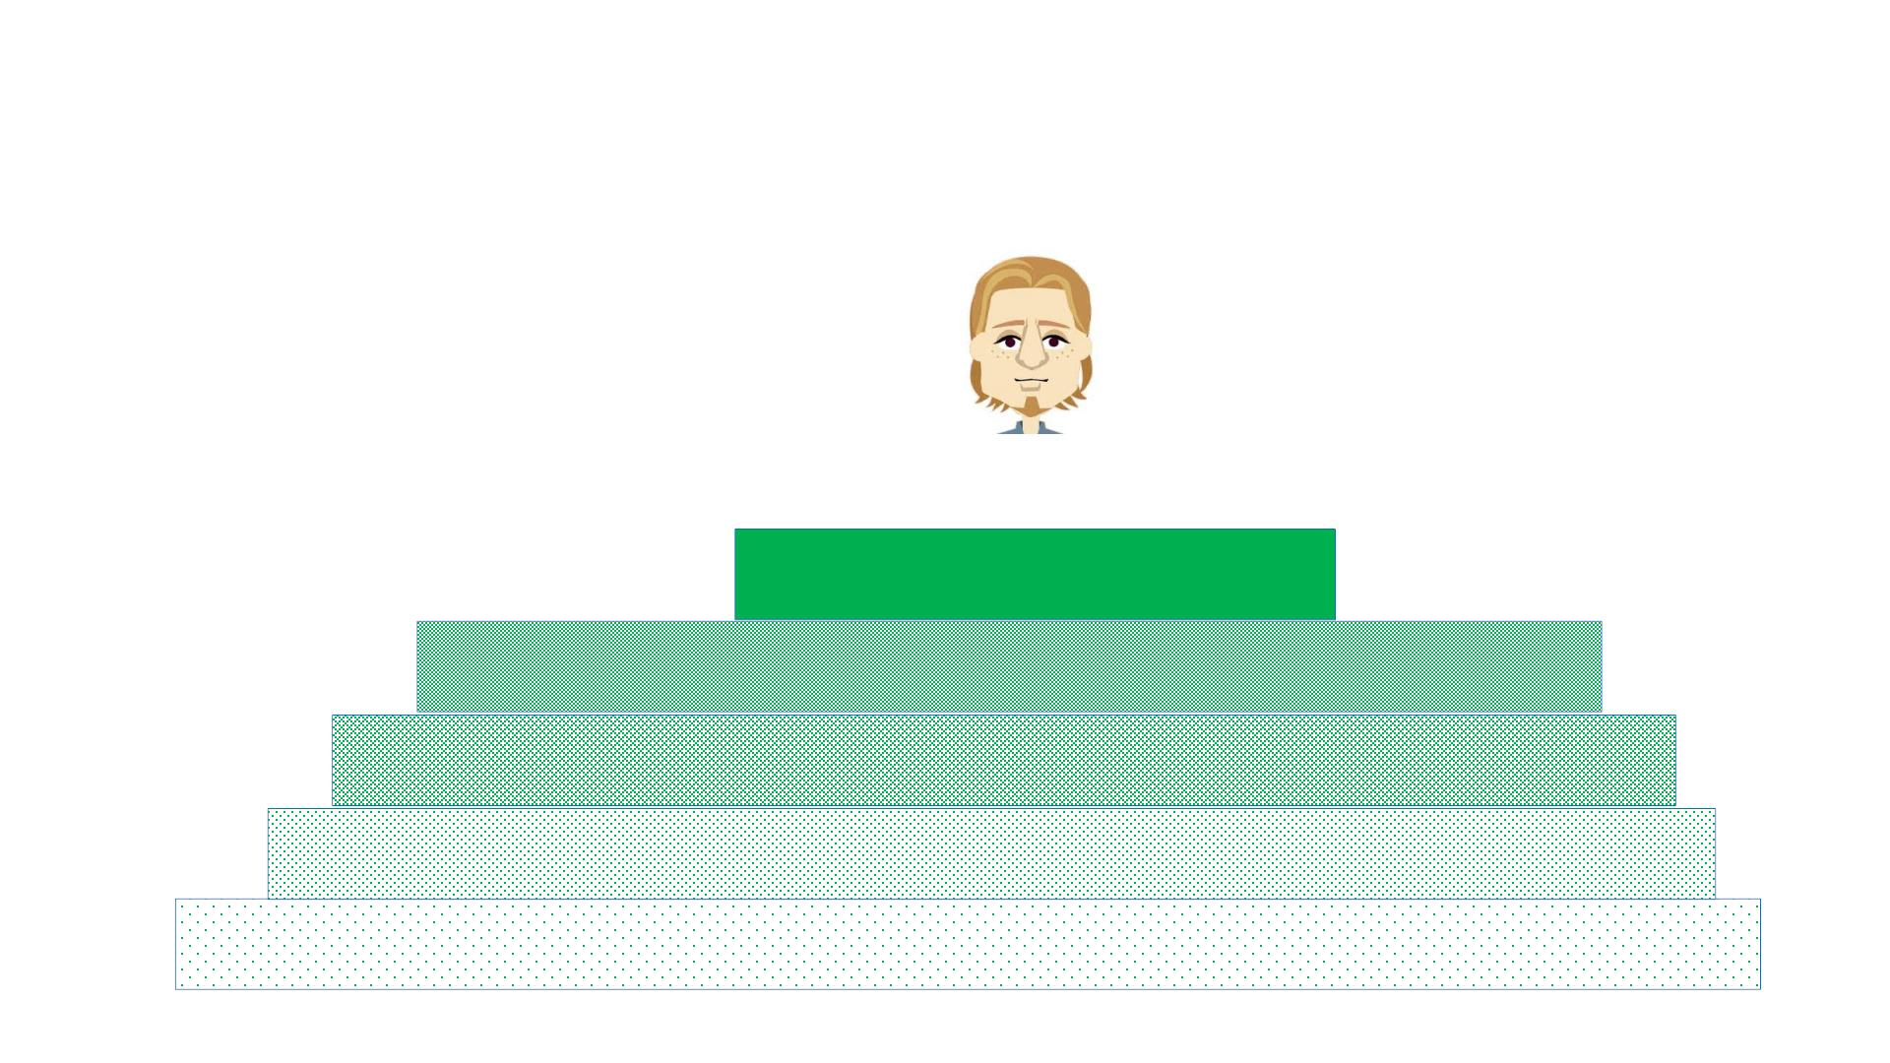
ChatGPT Architecture
UI: ChatGPT
Foundation Model(s): e.g., GPT-4
Attention Mechanism, polysemy(multiple meanings) w/ context
Word2vec, similarity
Knowledge ,represented by a huge set of documents
4/3/23
CS372 Spring Lecture #1
19

Slide 82
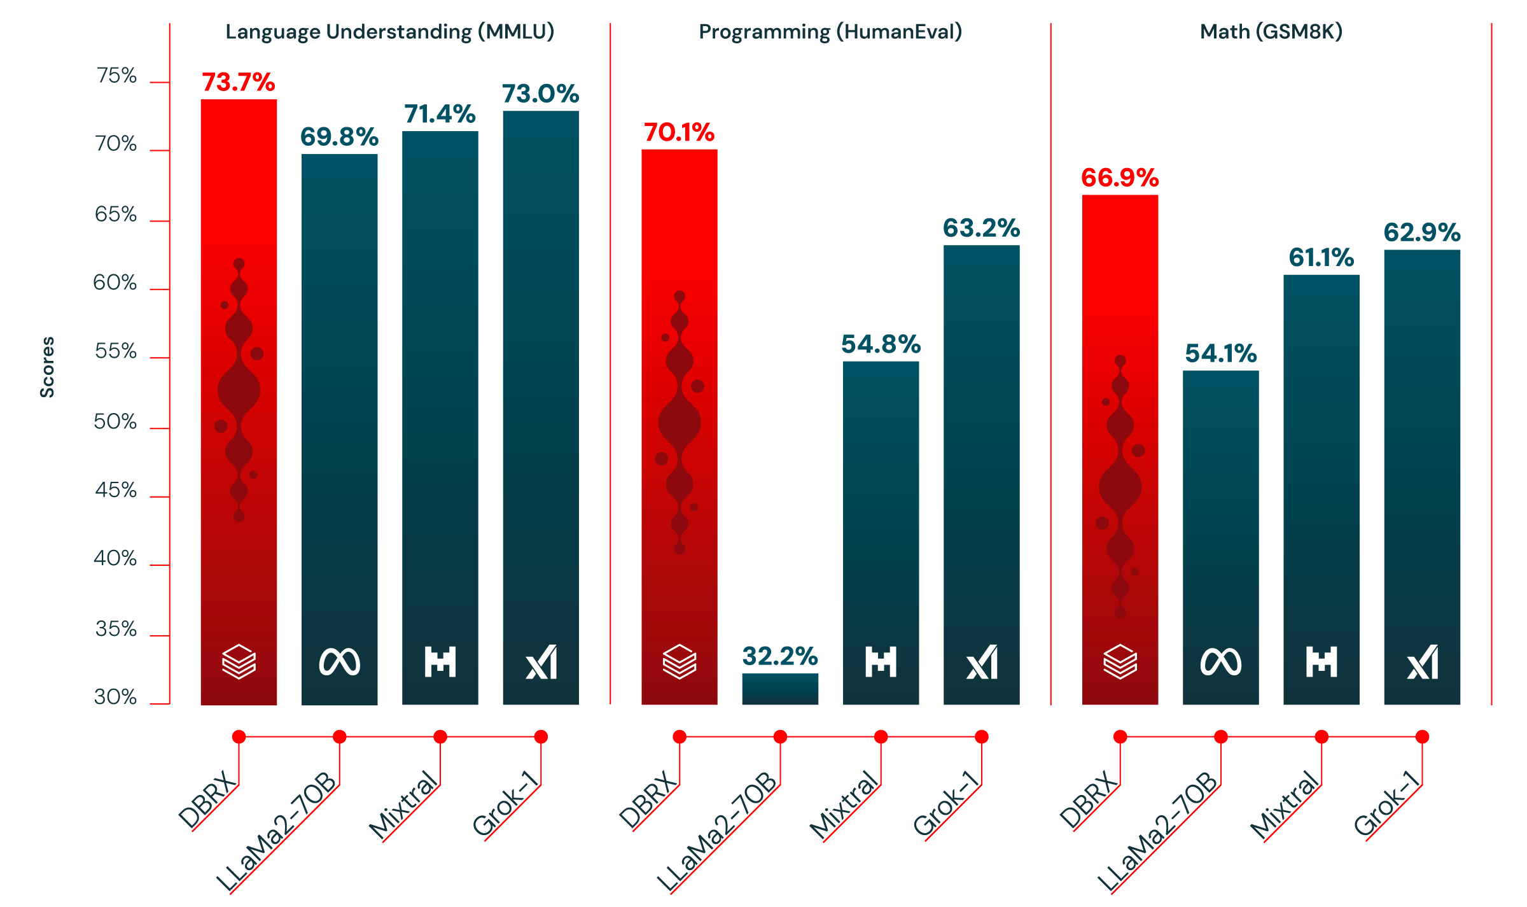
Comparison of Open Source Large Language Models (LLMs)

Slide 83
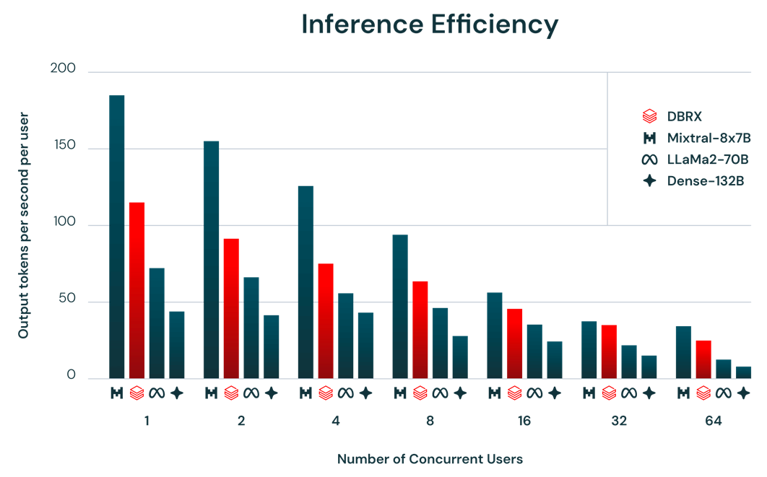
Inference Efficiency of Open Source LLMs

Slide 84

Text To Text Transfer Transformer (T5)
Google
Encoder-decoder transformer
No bias in layer normalization
Using relative positional embedding
Placing layer normalization outside the residual path
CC(Common Crawl) Dataset
20 TB each month
C4 Dataset (Huggingface)
750 GB
mT5(multi lingual)T5
mC4
Exploring the Limits of Transfer Learning with a Unified Text-to-Text Transformer (JMLR 2020)

Slide 85
Text To Text Transfer Transformer (T5)
Machine translation
WMT
QA
SQuAD
Summarization
NEWS
Text classification
GLUE
Task prefix
Exploring the Limits of Transfer Learning with a Unified Text-to-Text Transformer (JMLR 2020)

Slide 86
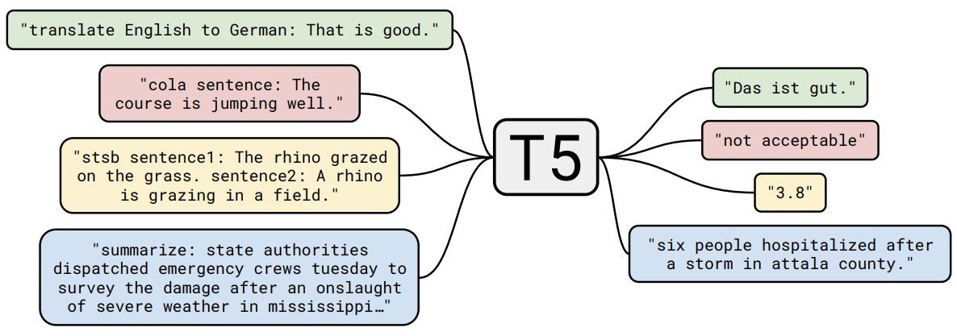
Text to Text Transfer Transformer (T5)
Exploring the Limits of Transfer Learning with a Unified Text-to-Text Transformer (JMLR 2020)

Slide 87
Gemini
Latest: Gemini 1.5 Pro
Gemini Ultra performs better than ChatGPT on 30 of the 32 academic benchmarks in reasoning and understanding it tested on.
Effectively processes and integrates data from diff modalities:
Text, audio, image, video
Based on a Mixture-of-Experts (MoE) model
Significantly improves efficiency in training and application
Notes:
MoE works similarly. It is a combination of multiple small Neural networks known as ‘Experts’ which are trained and capable of handling particular data and performing specialised tasks. Then there is a ‘Gating network’ (the aggregator in the Q&A example) which predicts which response is best suited to address the request.

Slide 88
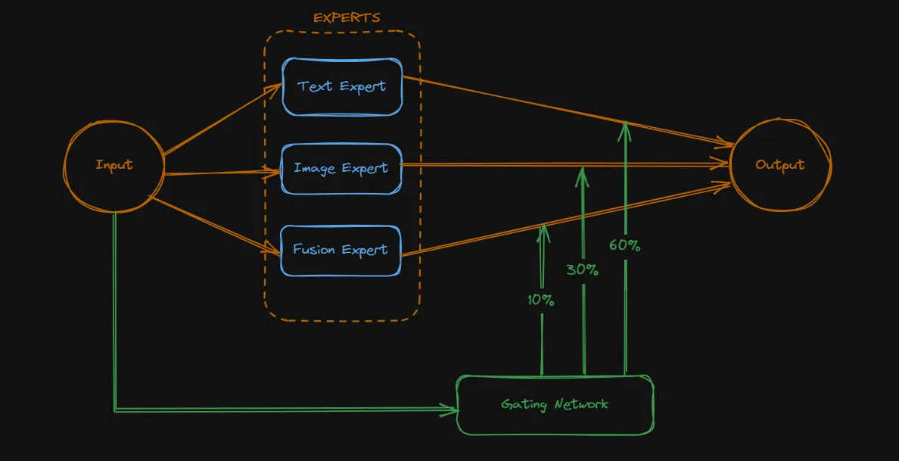
Gemini
Based on a Mixture-of-Experts (MoE) model
Combination of multiple small Neural networks known as ‘Experts’ which are trained and capable of handling particular data and performing specialised tasks.
‘Gating network’ which predicts which response is best suited to address the request.
Source link
Notes:
MoE works similarly. It is a combination of multiple small Neural networks known as ‘Experts’ which are trained and capable of handling particular data and performing specialised tasks. Then there is a ‘Gating network’ (the aggregator in the Q&A example) which predicts which response is best suited to address the request.

Slide 89
Thank you for the patience
Add on slides follow

Slide 90
Current trends in LLMs
LLMs till now built primarily built on the conventional Transformer architecture – powerful but has 2 drawbacks
• Large memory footprint: Transformer's memory footprint scales with context length. This makes it challenging to run long context windows or numerous parallel batches without extensive hardware resources, limiting widespread opportunities to experiment and deploy
• Slow inference as context grows: Transformer’s attention mechanism scales quadratically with sequence length and slows down throughput, as each token depends on the entire sequence that came before it—placing long context use cases outside the scope of efficient production
Proposed by researchers at Carnegie Mellon and Princeton Universities, Mamba addresses exactly those shortcomings, opening a new frontier of possibility for language model development
However, without attention over the entire context, this architecture struggles to match the same output quality of the best existing models, especially on recall-related tasks
Mixture of Experts(MoE) a machine learning technique where multiple expert networks (learners) are used to divide a problem space into homogeneous regions. It differs from ensemble techniques in that for MoE, typically only one or a few expert models are run for each input, whereas in ensemble techniques, all models are run on every input
To capture the best that both Mamba and Transformer architectures have to offer, a team of researchers(Lieber et al) from AI21Labs proposed Joint Attention and Mamba (Jamba) architecture
Composed of Transformer, Mamba, and Mixture-of-Experts (MoE) layers, Jamba optimizes for memory, throughput, and performance—all at once

Slide 91
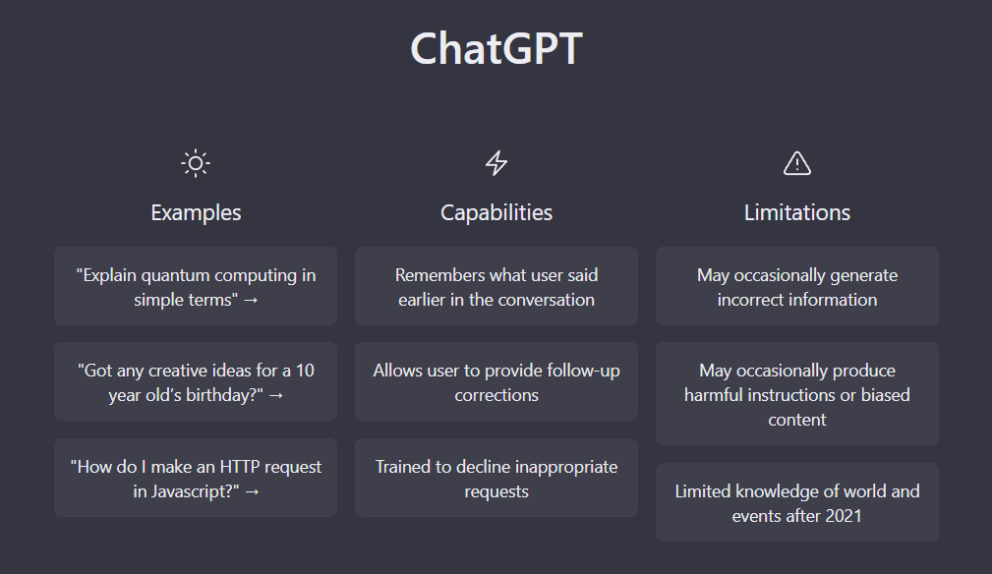
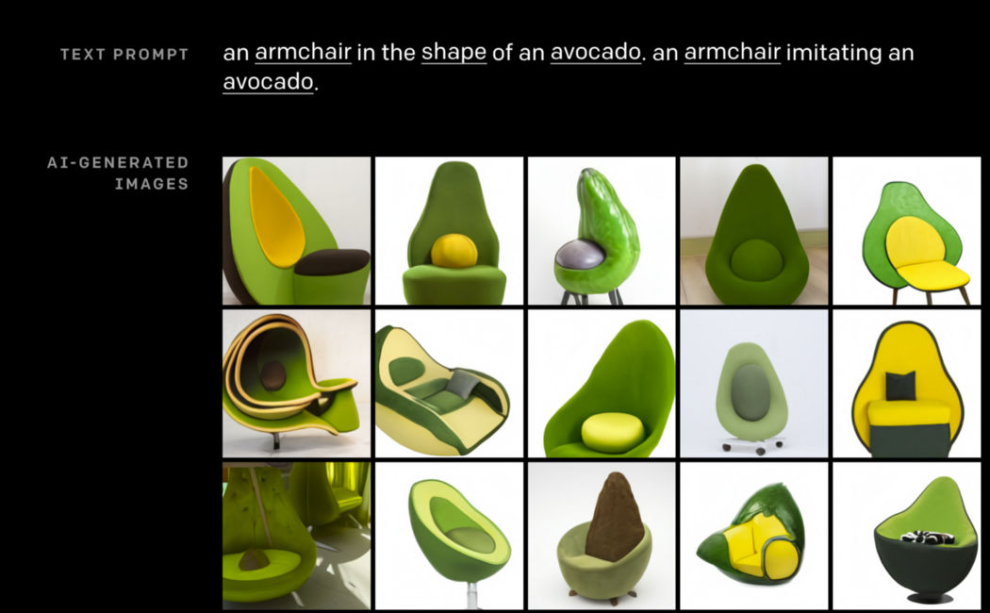
Where we are (2024)
Recently Taken Off:
LLM boom: ChatGPT, GPT-4, Gemini, open-source models
Human alignment and interaction
Reinforcement learning & human feedback
Controlling toxicity, bias, and ethics
More use in unique applications: audio, art/music, neuro/bio, coding, games, physical tasks, etc.
Speakers will touch (or have touched) on these!
Other: diffusion models (e.g. text-to-image/video gen)
Also, Diffusion Transformer (DiT)
Image source: https://openai.com/blog/chatgpt/

Slide 92
The Future (What’s Next?)
Can enable a lot more applications:
Generalist Agents
Longer video understanding and generation, finance + business
Incredibly long sequence modeling (GPT authors a novel)
Domain-specific “Foundation models” - DoctorGPT, LawyerGPT, …
Potential real-world impacts:
Personalized education and tutoring systems
Advanced healthcare diagnostics, environmental monitoring & protection, etc.
Real-time multilingual communication
Interactive entertainment & gaming (e.g. NPCs)

Slide 93
The Future (What’s Missing?)
Missing Ingredients (to AGI/ASI?): AGI- Artificial Intelligence ASI-Artificial Super Intelligence
Reducing computation complexity
Enhanced human controllability
Alignment with language models of human brain
Adaptive learning and generalization across domains
Multi-sensory multimodal embodiment (e.g. intuitive physics and commonsense)
Infinite/external memory: like Neural Turing Machines
Infinite/constant self-improvement and self-reflection capabilities
Complete autonomy and long-horizon decision-making
Emotional intelligence and social understanding
Ethical reasoning and value alignment

Slide 94
Requiring Large Amounts of Data, Compute, and Cost
Current LLMs take immense amounts of data, compute, and $ to train
Requires training over weeks/months over thousands of GPUs
BabyLM challenge: can we train LLMs using similar amounts of data a baby is exposed to while growing up?

Slide 95

BabyLM: Children vs. LLMs
Children are different due to several reasons:
LMs do statistical learning, which requires more data to learn statistical relations between words and get abstraction/generalization/reasoning
Children may learn in smarter, e.g. more explicit compositional/hierarchical manners, learning abstraction/generalization/reasoning more easily
Notes:
CNNs learn more high-level/abstract features per layer
E.g. baby sees a cat once or twice and can generalize to all cats, but models need to see them much more

Slide 96
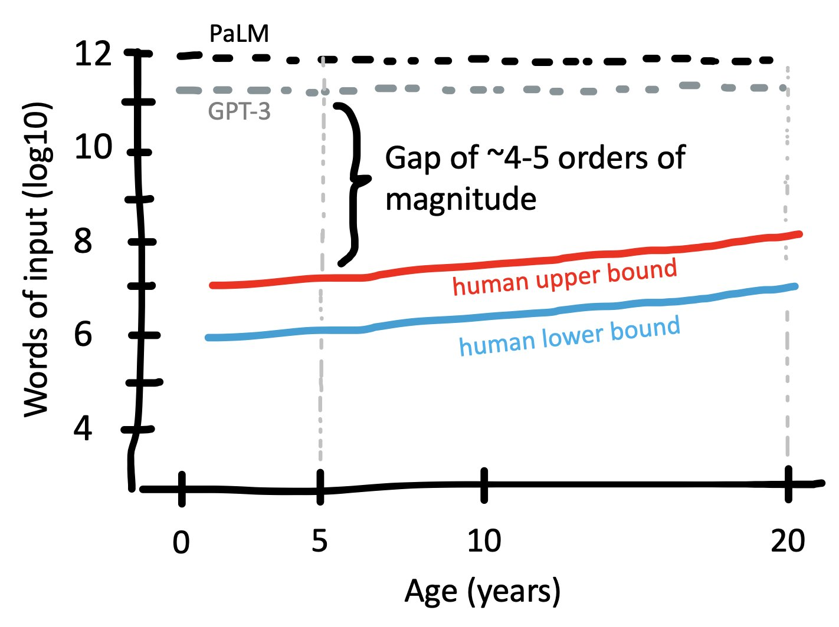
BabyLM: Children vs. LLMs
Thoughts/ideas from Michael C. Frank’s tweet
4-5 orders of input magnitude diff b/w human and LLM emergence
Factor 1: Innate knowledge - relates to priors
Factor 2: multimodal grounding
Factor 3: active, social learning
Factor 4: evaluation differences
Notes:
Factor 3: - “peer reflection” (machine-machine interaction) and “human feedback” (machine-human interaction)
Factor 4: are “benchmarks” really assessing them appropriately?

Slide 97
Minified LLMs and On-Device LLMs
Big trend of using LLMs for applications and everyday purposes
A requirement is ability to run quickly and easily on-devices
AutoGPT and ChatGPT “plug-ins”
Right now, work on smaller open-source models (e.g. LLaMA, Mistral)
In the future: ability to finetune and run models locally, even on your phone!
Getting more possible due to more open-source, but still very large and $

Slide 98

Memory Augmentation & Personalization
Weakness of LLMs is that they are frozen in knowledge at a particular point in time, and don’t augment knowledge “on the fly”
Hope to be able to remember the information while chatting with a particular user, both within the same conversation and across conversations
Would help with context window limits and adapting to the particular user
Widescale: somehow update the model “on the fly” with info from several users
Further, they usually do not adapt their talking style and persona to the particular user, which could have applications such as mental health therapy

Slide 99

Memory Augmentation & Personalization
Potential approaches:
Memory bank - not feasible/efficient with larger amounts of data
Prefix-tuning approaches (finetune a small part of the model) - too expensive
Some prompt-based approach - do not see how this would be possible to change the model itself, but can at least help it “personalize” to the user
RAG: retrieval-augmented generation (data store, augment context each time)
Relies on high-quality external data store
Typically not end-to-end
Not within the “brain” of the model but outside:
Suitable for knowledge/facts, but not fundamental capabilities and skills

Slide 100

Pretraining Data Synthesis & Selection
Lots of work these days on synthetic data generation (e.g. using GPT-4) to train other models, e.g. smaller models or peer models
More work on understanding how to best synthesize and select the pretraining data
Related to model distillation: knowledge from a large complex model (Teacher) is transferred to a smaller, more efficient model (student)
Goal: achieve similar performance with less computational cost
Example: Microsoft Phi models (“Textbooks Are All You Need!”)
https://arxiv.org/abs/2306.11644
Nathan Lambert’s Summary on Synthetic Data in his Interconnect Newsletter

Slide 101

Microsoft Phi-2 Model
Phi-2, a 2.7 billion-parameter model, excels in reasoning and language understanding, challenging models up to 25x larger
Emphasizes "textbook-quality" training data and synthetic datasets for teaching common sense and general knowledge
Training data mix: synthetic datasets to teach the model commonsense reasoning and general knowledge, including science, daily activities, ToM, etc.
Further carefully selected web data filtered by educational value + content quality
Phi-2 designed as a resource for research on interpretability, safety improvements, and fine-tuning across tasks

Slide 102

New Knowledge or “Memorizing”?
When LLM is prompted and says something, is what it says truly “novel/new”?
Innovation vs. Regurgitation: ongoing debates about whether LLMs can truly invent new ideas or are primarily recombining existing knowledge (since learn patterns from lots of text)
Test-time Contamination: models might regurgitate rather than synthesize information due to overlap between training and evaluation data, leading to misleading benchmark results
Cognitive Simulation: some argue LLMs mimic human thought processes, suggesting a form of "understanding," while others see this as simply “sophisticated pattern matching”
Ethical and Practical Implications: this impacts trustworthiness, copyright issues, and the educational use of LLM outputs
E.g. copyright lawsuit by New York Times (NYT) on OpenAI!

Slide 103

Continual Learning
AKA, infinite and permanent fundamental self-improvement
Similar to humans: we constantly learn everyday from every interaction
Don’t need to “finetune ourselves” once in a while
Very challenging, could be the key to AGI!
Currently work on: finetune a small model based on traces from better model or same model after filtering those traces
More like re-training and distillation than true “continual learning”
Work showing that reasonably sampled data with interjected augmented reasoning and further filtering can be used to further finetune or optimize (e.g. using DPO)
E.g. UltraChat-200k and Zephyr
E.g. LLMs Can Self-Improve paper

Slide 104

Interpretability of LLMs
Enormous number of parameters trained on tons of data → “huge black-box” that is hard to interpret and understand
More work on interpretability is required
Would allow us to better understand models, leading to better ideas of what/how to improve, easier control, and better alignment/safety
Mechanistic interpretability: understand how individual components + operations in an ML model contribute to its overall decision-making process
Goal: unpack the "black box" of models for clearer insight into how they work

Slide 105

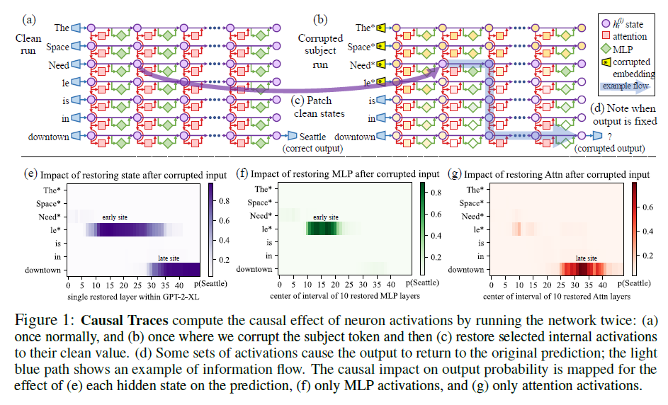
Model Editing & Mechanistic Interpretability
Also work on mechanistic interpretability and model editing (e.g. edit specific nodes)
Relevant paper: https://arxiv.org/abs/2202.05262
Development of a causal intervention method to trace decisive neuron activations for model factual predictions
Rank-One Model Editing (ROME) to modify model weights for updating factual associations
Mid-layer feedforward modules play a significant role in storing factual associations
Manipulation of these can be a feasible approach for model editing

Slide 106
References
[1] Attention is all you need, Vaswani et al. arXiv 2017
[2] Assessing BERT’s Syntactic Abilities, Goldberg, 2018
[3] Language_models_are_unsupervised_multitask_learners, Radford et al 2018
[4] Improving Language Understanding by Generative Pre Trainer Redford et al 2018
[5] What do you learn from context? Probing for sentence structure in contextualized word representations, Tenney et al., 2018 [6] Learning and Evaluating General Linguistic Intelligence, Yogatama et al., 2018
[7] RoBERTa A Robustly Optimized BERT Pretraining Approach Liu et al. arXiv 1907.11692
[8] ALBERTa A Lite BERT for Self-supervised Learning of Language Representations, Lan et al. ICLR 2020
[9] DistilBERT, a distilled version of BERT: smaller, faster, cheaper and lighter, SANH et al.
arXiv 2020
[10] GPT Understands, Too, Liu et al. arXiv 18 March 2021

Slide 107

[11] On the Opportunities and Risks of Foundation Models, Bommasani et al, arXiv:2108.07258v3 [12] Scaling Language Models Methods, Analysis & Insights from Training Gopher Rae et al arXiv 2112.11446 [13] PaLM: Scaling Language Modeling with Pathways, Chowdhery et al arXiv:2204.02311 [14] BLOOM A 176B-Parameter Open-Access Multilingual Model BigScience Workshop arXiv 2211.05100 [15] LLaMA: Open and Efficient Foundation Language Models Touvron et al. arXiv:2302.13971 [16] GPT-4 Technical Report OpenAI arXiv 2303.08774 [17] Baichuan 2 Open Large-scale Language Models Yang et al arXiv 2309.10305 [18] Mistral 7B Jiang et al arXIv 2310.06825 [19] Mamba: Linear-Time Sequence Modeling with Selective State Spaces, Gu et al arXiv 2312.00752[ [20] Gemini: A Family of Highly Capable Multimodal Models, Gemini Team arXiv:2312.11805v2 [21] Gemma: Open Models Based on Gemini Research and Technology, Mesnard et al. arXiv:2403.08295v4 [22] Jamba: A Hybrid Transformer-Mamba Language Model, Lieber et al, arXiv:2403.19887
References

